Slide 1
Properly sorting our waste: …Where does it go?
Informative material intended for teachers
EDUCATIONAL KIT TO SAVE THE LAND | FNQLSDI

Slide 2
A message for the teacher
This presentation was designed to provide additional information to the teacher prior to beginning the activities of the Educational Kit.
It should be used as a reference guide to further explore the themes of the challenges addressed in the Educational Kit.
The PowerPoint presentation is designed specifically for teachers, but it can be used without any problems, in whole or in part, as visual support with the students.
Structure of the presentation:
Why sort our waste?
Recycling with the blue bin
Recycling with the ecocentre
Recycling with other drop-off points

Slide 3
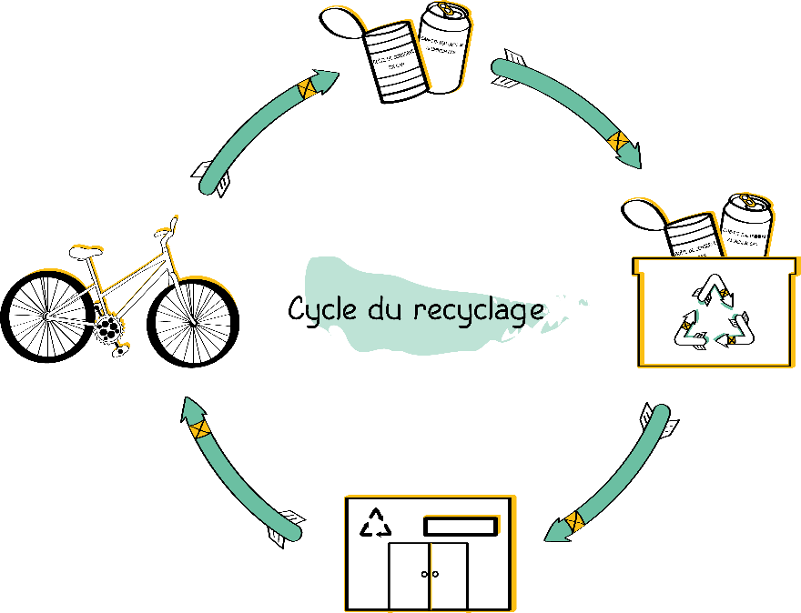
Why recycle?
Cycle of recycling
The ultimate goal of recycling is to reintroduce waste into a production cycle to manufacture new products. In other words, it consists of making new things with old things!
Materials that are recycled are used to completely or partially replace a raw material in the manufacture of a product. They help to reduce the amount of natural resources extracted from the environment. This is much better than allowing them to perish in a landfill!

Slide 4
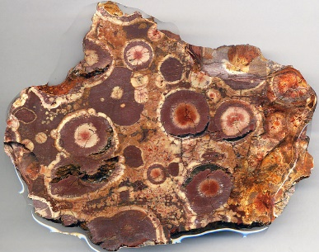
Why recycle?
Recycling cardboard avoids the chopping down of thousands of trees each year.
Recycling glass saves sand and preserves our beaches and soils.
Recycling plastic reduces oil consumption.
Recycling aluminum reduces the extraction of bauxite, a rock rich in alumina (Al2O3) and iron oxides.
What is the difference with reuse ? With recycling, the material undergoes a transformation in order to be reintegrated into the production chain.

Slide 5
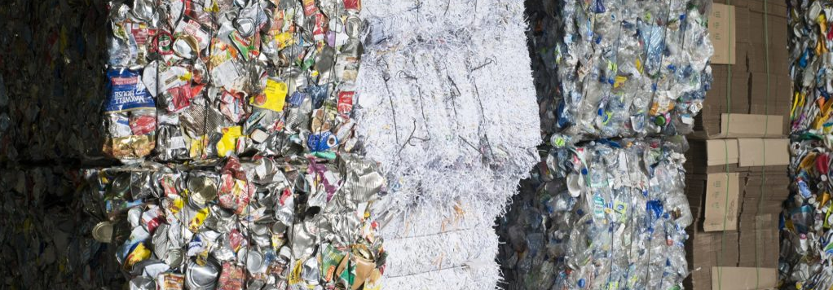
Why recycle?
Recycling also has an economic benefit: it is much cheaper for the community to recycle than to bury its waste.
From the outset, it may seem absurd to pay for our waste. In fact, it is about 50% more expensive to put our recyclable materials in the garbage can instead of the blue bin.
On average, burying a ton of waste costs $90, while a ton of recyclable materials costs $45 to process.

Slide 6
Why recycle?
Let's do a brief calculation.
Let’s suppose we have a community of 890 people.
The national production average per capita and per year is 685 kg. Let's also consider that, on average, 40% of our waste is recyclable. The following would be the costs for this community if:
 | LANDFILL $ | RECYCLING $ | TOTAL $ | SAVED $
Nobody recycles | $54,869 | $0 | $54,869 | $0
5% of the people recycle | $53,771 | $549 | $54,320 | $549
25% of the people recycle | $49,382 | $2,743 | $52,125 | $2,743
50% of the people recycle | $43,895 | $5,487 | $49,382 | $5,487
100% of the people recycle | $32,921 | $10,974 | $43,895 | $10,974
You can see that, after one year, with a participation rate of 50%, nearly $5,500 is saved. By extending this practice for just 10 years, the community would have an extra $55,000 that could be invested in projects to improve or galvanize the community rather than investing it in waste treatment.
It is for this reason that recycling is much more profitable than burying it!

Slide 7
The difference between recycled and recyclable

Slide 8
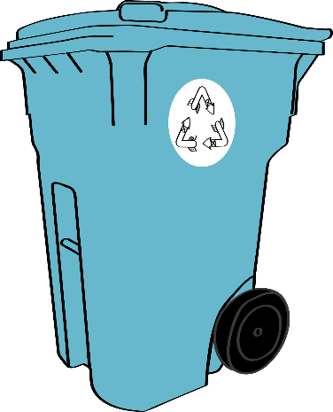
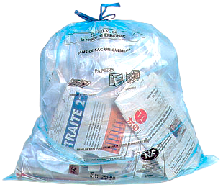
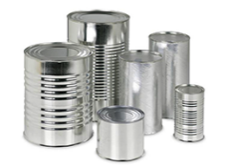
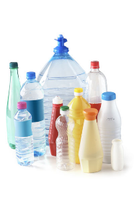
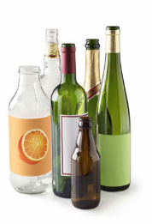
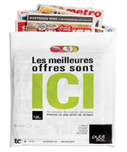
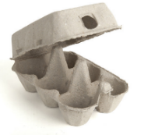
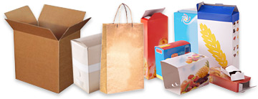
Recycling with the blue bin
Now, we want to recycle! How do we go about sorting properly with the blue bin?
The basic trick to remember is simple:
Containers
4 categories
Paper and cardboard
Glass
Metal
Plastic
Paper
Packaging

Slide 9
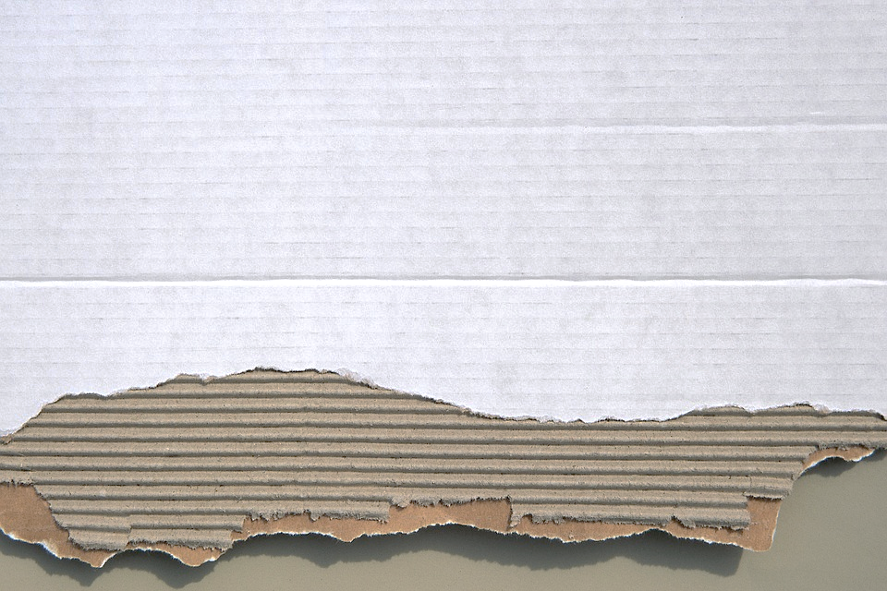
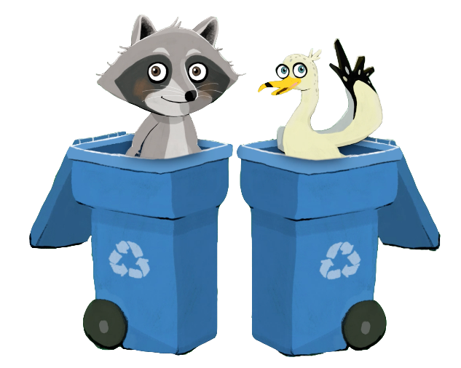
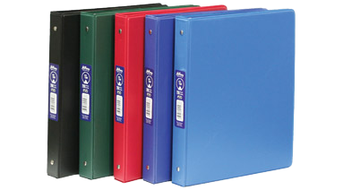
Recycling with the blue bin: paper and cardboard
What goes in the bin
Newspapers, flyers, catalogs and magazines
Sheets of paper (even with staples) and envelopes
Packaging for cereal, frozen foods, laundry detergent, shoes, cardboard tubes, etc.
Flattened cardboard boxes
Cardboard rolls
File folders
Paper bags
Directories
Milk and juice cartons with spouts
Aseptic containers (e.g., Tetra Pak packages)
Egg cartons
Brown paper grocery bags
Promotional inserts
Invoices
Lottery tickets
Most papers and cardboards go into the recycling bin. To avoid contaminating other materials, it is important to avoid recycling paper or cardboard that is soaked in grease. If you have access to organic waste collection, you can put it in your brown bin instead!
WARNING! The following cannot be recycled: wax paper, stickers, wallpaper, photographic paper, metallized wrapping paper, padded envelopes, diapers and objects made of different materials such as school binders.

Slide 10
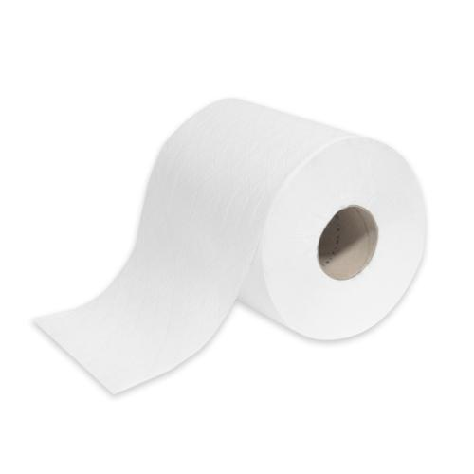
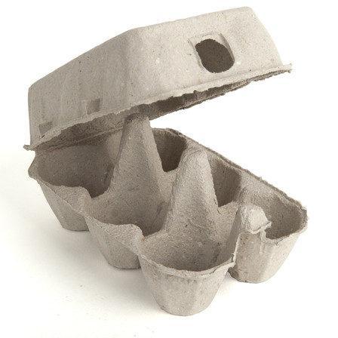
Paper outputs
FINE PAPER | NEWSPRINT
Flat and corrugated cardboard Household paper: Writing paper Printable paper Toilet paper Kleenex Paper towels Napkins Postal envelopes | Molded pulp packaging (egg cartons) Fruit insulators Animal litter Flat cardboard: Shoe and cereal boxes Newspapers Telephone directories Stuffing and construction materials: Cellulose thermal insulation Soundproofing materials Ceiling panels Pen components

Slide 11
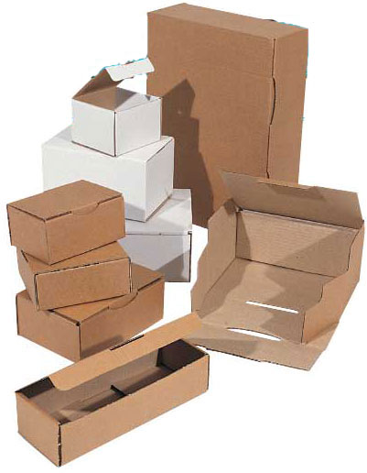
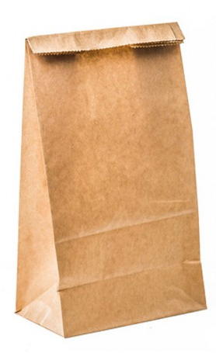
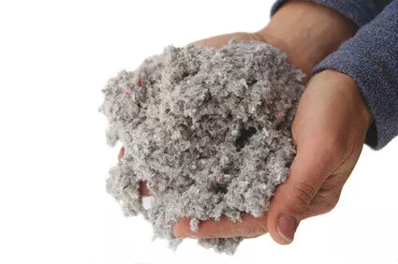
Cardboard outputs
CARDBOARD
Cardboard boxes Kraft paper Construction materials: Roof covering Cellulose insulation Pen components Compost

Slide 12
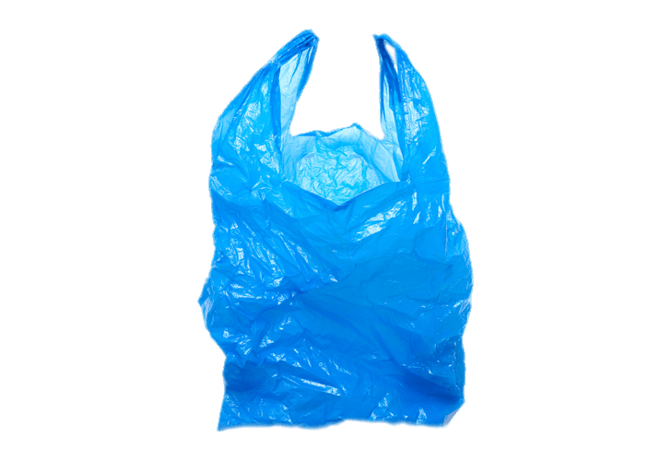
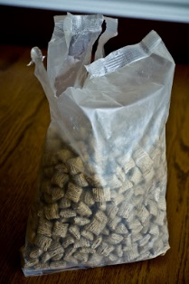
Recycling with the blue bin: plastic
What goes in the bin
Flexible plastic
Shopping bags
Bread, pastry or food bags (clean and grease free)
Hard plastic
Bottles of water, juice, beverages, etc.
Bottles of oil and vinegar
Bottles of laundry soap and bleach
Lids and caps
Containers for ice cream, margarine and yogurt
Containers and packaging for food products
Containers for strawberries, raspberries, blueberries, etc.
Containers for beauty products, personal hygiene and household cleaning
Transparent packaging for small electronic devices
Transparent egg packaging
Containers for ready-to-eat dishes
The trick to know if a plastic bag is recyclable: if you stretch it, does it break or does it ... stretch?
If it breaks, into the garbage can it goes.
If it stretches then it can indeed be recycled!

Slide 13
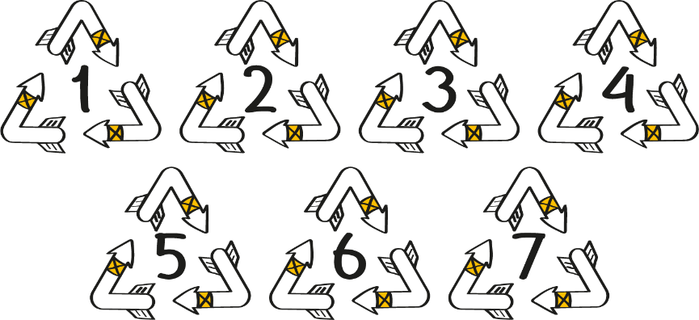
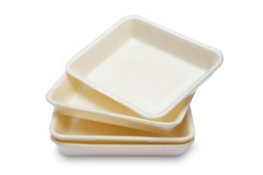
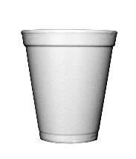
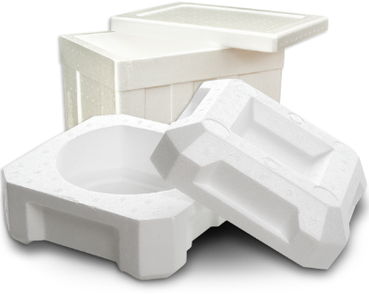
Recycling with the blue bin: plastic
Clarifications on plastic…
Almost all plastic containers and packaging identified by numbers 1, 2, 3, 4, 5 and 7 can be deposited in the recycling bin..
WARNING ! Plastic labelled is not yet recycled in all regions.
Check with your community’s department of public works or environment to find out whether it is accepted in your blue bin!
If the service is not available, inquire at your ecocentre, perhaps you can accumulate it and deposit it there.
Why is it so difficult to recycle polystyrene?
The answer, both simple and complicated, can be summed up by its light weight. Polystyrene is 95% air. Transporting it is therefore very expensive compared to other types of plastic, since the same weight takes a lot of space!

Slide 14
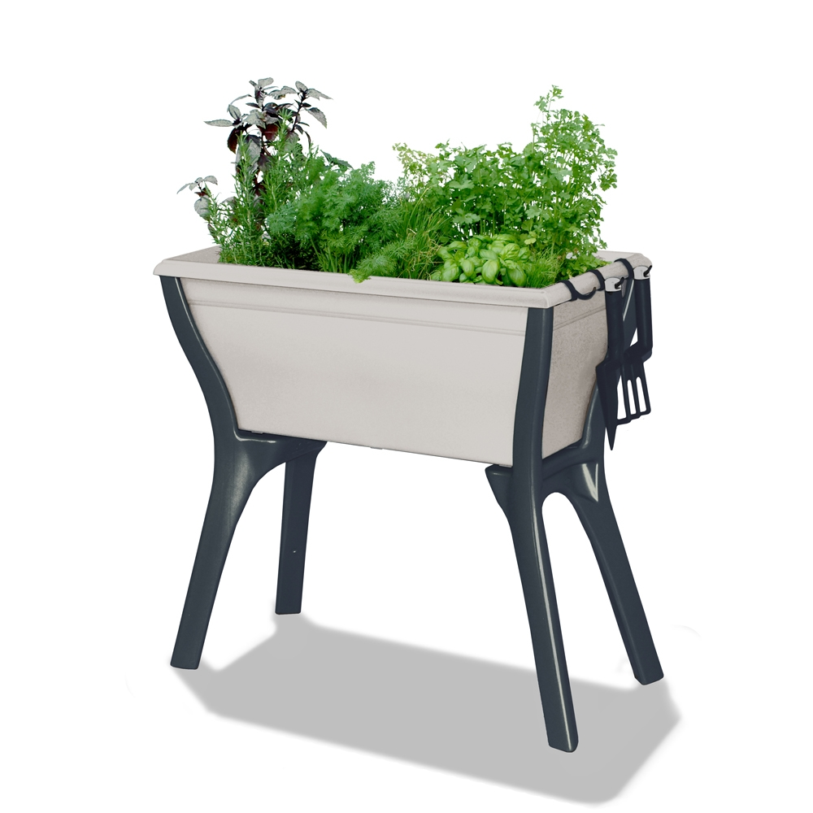
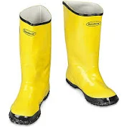
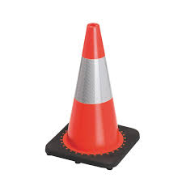
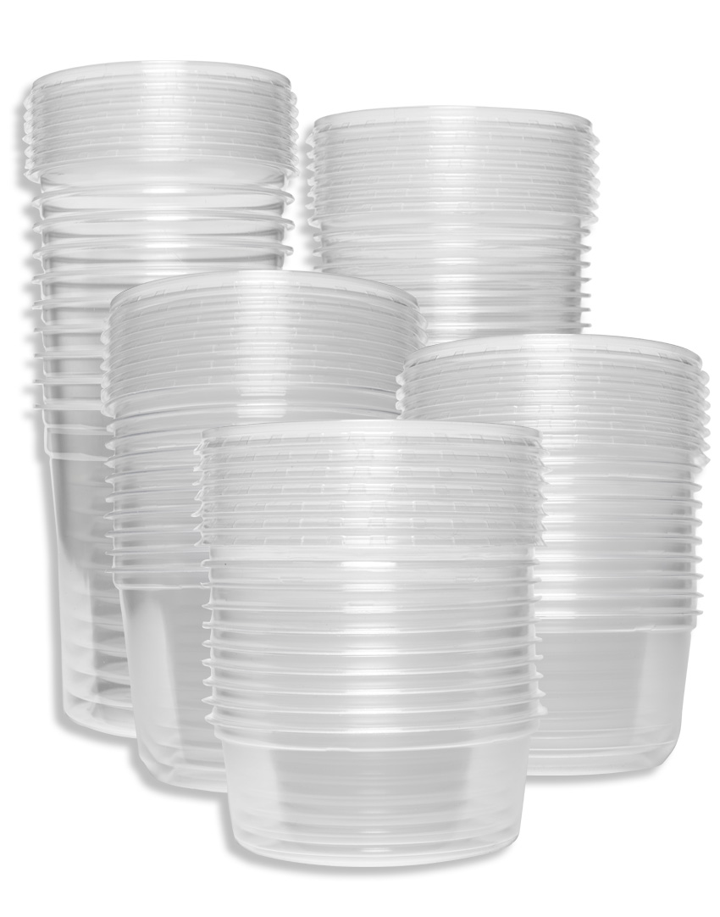
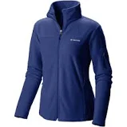
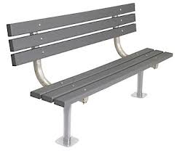
Plastic outputs
PLASTICS
Shopping and garbage bags Containers and lids Garden furniture Fleece clothing Toys Flower boxes Urban furniture Fences Rain boots Pipes (drainage, irrigation) Loading pallets Waste baskets Boards for patios and balconies Office equipment | Skate blade protectors Ramps Polyester fibres Clothespins Waste oil collection containers Geomembrane Briefcases Auto parts (bumpers, batteries) Rope Combs Hangers Pen components Bathtubs | Various stakes Road cones Construction materials Appliance parts Audio/video cassettes Object handles (scissors, hairbrushes, etc.) Carpet Boat hulls Shower curtains Scouring pads Floor tiles Agricultural canvas Rolling bins

Slide 15
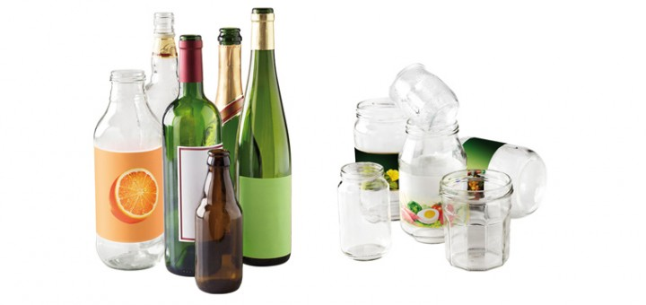
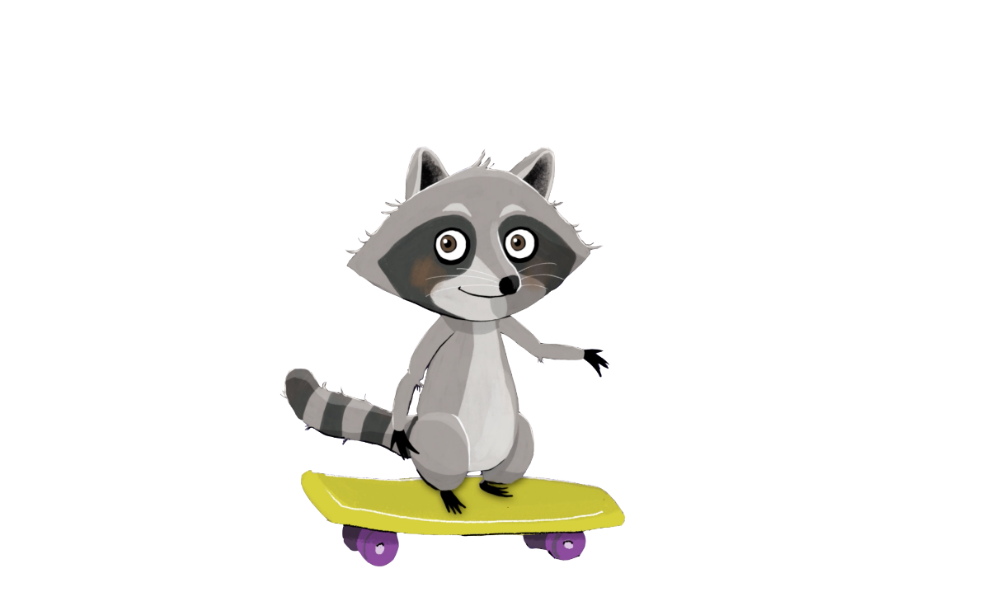
Recycling with the blue bin: glass
What goes in the bin
Bottles of wine, juice, carbonated water, etc.
Bottles of oil and vinegar
Jars for food and products (jars of pickles, salsa, sauce, etc.)
What does not go in the bin
Electric light bulbs
Porcelain and ceramic
Fluorescent tubes
Glass and mirrors
And if they are marked with “Consignée Québec Refund”, they must be returned to a retailer.
It's even better than in the blue box, and in addition, you recover the deposit you paid when buying your beverages!

Slide 16
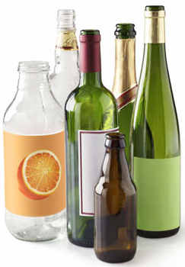
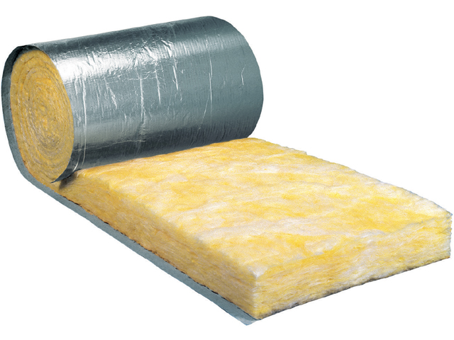
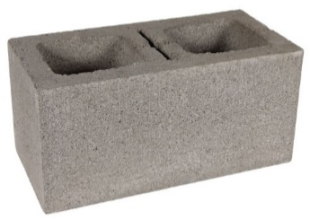
Glass outputs
GLASS
Containers: Bottles Jars Glasses Fiberglass insulation | Aggregates: Road foundation layers Concrete blocks Asphalt Paint microbeads Abrasive Ceramic tiles Sandblasting

Slide 17
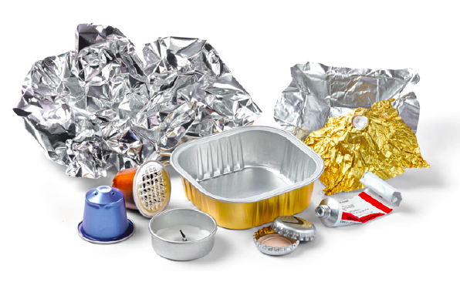
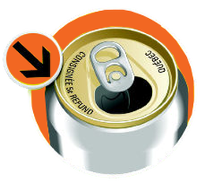
Recycling with the blue bin: metal
What goes in the bin
Food cans
Lids and caps
Aluminum cans and containers not marked “Consignée Québec Refund”
Aluminum plates, containers and aluminum foil (even if soiled)
Clarifications…
Metal aerosol containers go to the ecocentre
Cans with a deposit must be returned to a retailer
Do not forget ! If the cans are marked “Consignée Québec Refund”, they must be returned to a retailer!

Slide 18
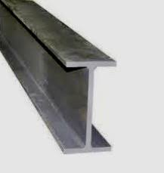
Metal outputs
STEEL | ALUMINIUM
Engine parts Tools Cans Nails Frames Flat laminates for household appliances Steel structures: Bridges Buildings Cars Fittings | Cans Wrapping paper Garden furniture Various containers Construction materials Auto parts: Cylinder head Rims Gearbox

Slide 19
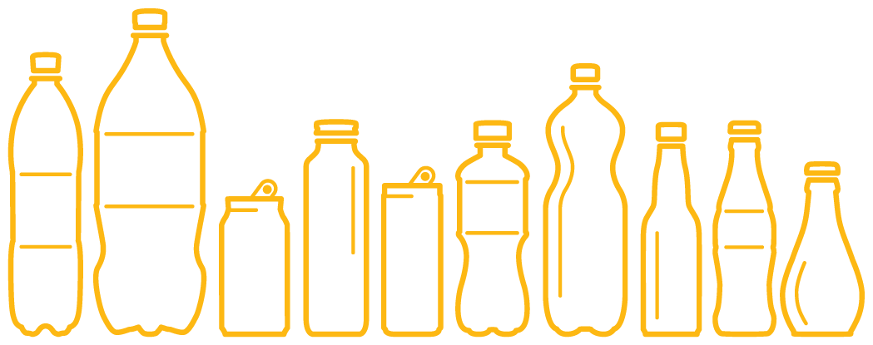
Recycling with deposit-refund is even better!
“A recovery method based on the temporary collection of a deposit when a container is sold.
This deposit is refundable to encourage consumers to return the container so that it can be recovered and recycled.
A deposit costs the person returning a container nothing. Only people who choose to throw away their containers pay the price. In Quebec, we pay deposits on beer and soft drink cans made of aluminum, as well as soft drink bottles made of glass or plastic. The deposit ensures that containers brought back to merchants are 100% recycled.”
- Consignaction
100 % of the glass recovered through deposit-refund is recycled compared to 37 % for the glass collected by the blue bin!

Slide 20
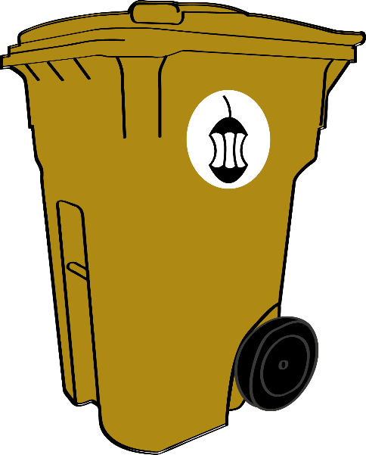
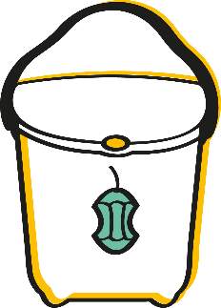
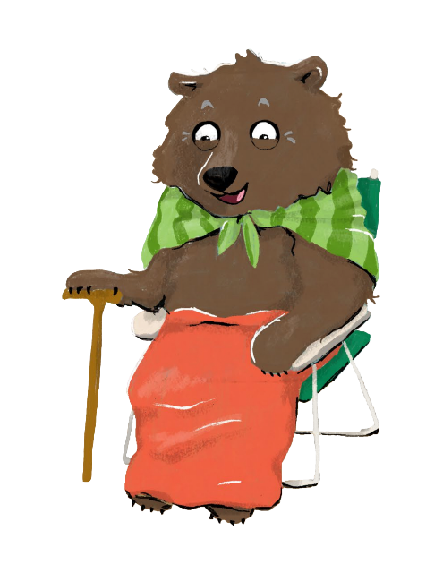
Recovering with the brown bin
Did you know that we can, in a way, recycle our organic matter through composting?
Here are three questions to ask yourself to figure out what goes in the brown bin:
Is it edible?
Is it paper or cardboard? (Is it soiled? If not, it goes to the recycling bin.)
Is it a garden waste? (Except for branches)
Composting is a natural process that we will further explore with challenge #4.
In short, it is the decomposition of organic matter.
What is organic matter? It is matter that makes up living things. All matter put into the compost is organic matter.
Garden waste and table scraps are placed in a small container.
Once this container is full, empty it into a composter or a brown bin if your community offers this service.
The result: a rich, brown soil with a forest soil fragrance that can be used in yards, flowerbeds and gardens.

Slide 21
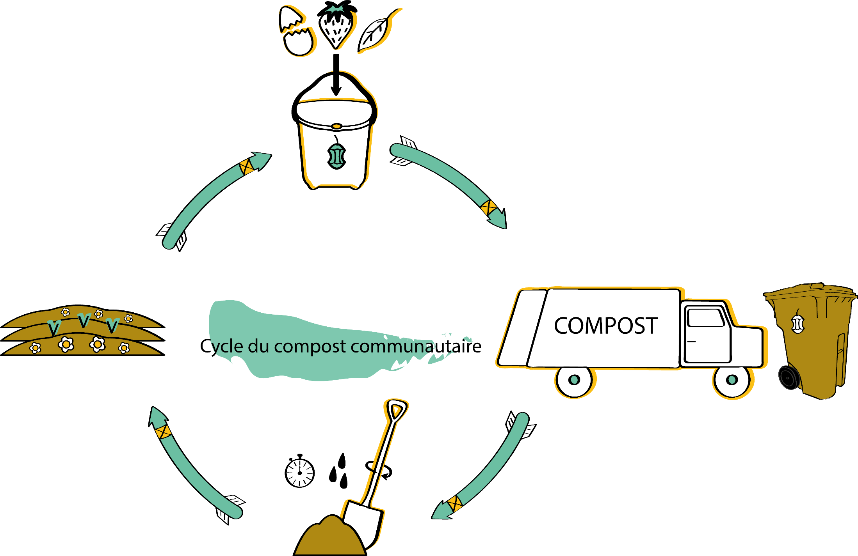
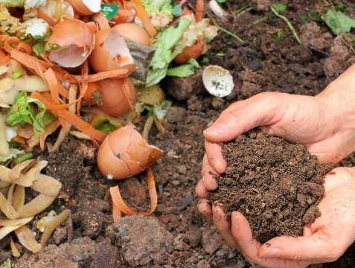
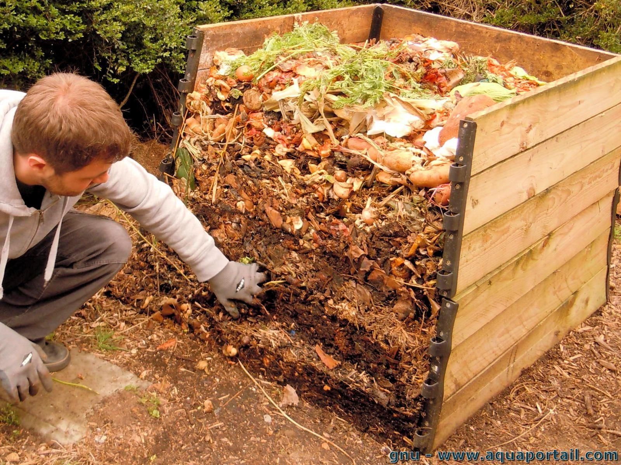
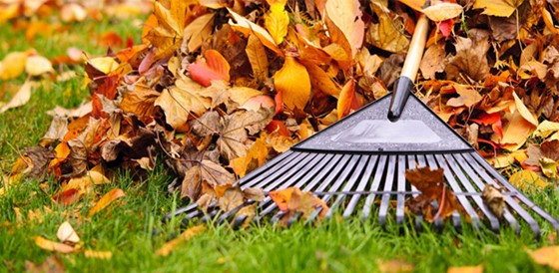
Cycle of community composting

Slide 22
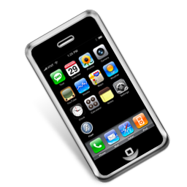
Recycling with the ecocentre
Take an old cell phone. You cannot put it in recycling, there is no deposit-refund and it does not go to composting either.
Does it really go to the trash? Never! For this item, we must go to the ecocentre.
The Ocki Aki Ecocentre in Kitcisakik
An ecocentre is a place where specific recyclable materials that are not accepted in the blue bin can be deposited.
For example: bulky items (sofas, televisions, tables, etc.), household hazardous waste (paint, electronic products, light bulbs, etc.), construction, renovation or demolition materials (metals, wood, concrete), etc.
The goal is to foster reuse (when still in good condition) or recycling.

Slide 23
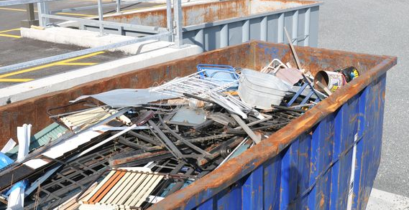
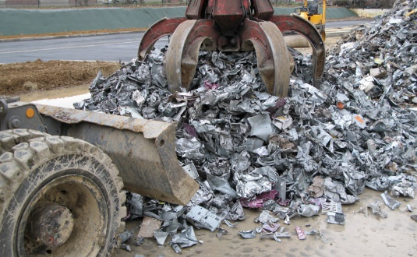
Recycling with the ecocentre
In order to recycle the materials it receives, an ecocentre has agreements with various waste collectors in its region.
For example, when an ecocentre has accumulated enough metal, a collector (say ProMetal Inc.) will pick up the cargo. ProMetal Inc. will then take care of reselling the metal or transforming it itself to reintegrate it into the production line, just like for recycling.
It is for this reason that ecocentres therefore do not all accept the same materials. Do your research, and find out from your community which materials are accepted at the nearest ecocentre!

Slide 24
Recycling with other drop-off sites
Specialized organizations go even further by offering to recycle specific “non-recyclable” items.
One thing is certain, thanks to these small initiatives, billions of waste items are being diverted from landfills and incineration.
PROS | CONS
Helps further reduce our final waste | Very local We must do our research to find them

Slide 25
Recycling with other drop-off sites
TerraCycle can recycle: used pens and pencils, plastic gloves from factories, coffee and tea accessories, incandescent bulbs, earplugs, coffee capsules, shoes, and much more!
ReCork can recycle: corks, which are 100% recyclable (but not in the blue bin)!
How does it work?
Usually, these organizations sell or offer boxes for the recycling of these specific materials.
Shops and workplaces can order these boxes and become a drop-off site for these special items!
That's why, once again, you have to do your research to be aware of what is being recycled near your home!

Slide 26
The final waste: into the garbage bin!
Once all the materials are sorted into the right place, only a small quantity of waste remains to be sent for elimination.
This remaining waste is called final waste!
This is waste that cannot be recycled or composted and which is not accepted by an ecocentre or another drop-off site.

Slide 27
And now, are you ready to sort properly?

Slide 28
Sorting properly, for starters!
Sorting your waste is one of the easiest things you can do to help Mother Earth. When we pay attention, we come to realize that almost all objects find a place at the end of their useful life, and that few objects are actually intended for the landfill. During this challenge, have fun as much as your students by practicing your “sorting” skills!
The other challenges of the Educational Kit also prepare you to deal with the problem at its roots: the way we consume and the way we manage our waste.
Challenge 1: Properly sorting our waste: Where does it go?
Challenge 2: Zero waste
Challenge 3: Household hazardous waste
Challenge 4: Composting
Challenge 5: My ecological footprint

