Slide 1
Zero Waste Objective!
Informative material intended for teachers
EDUCATIONAL KIT TO SAVE THE LAND | FNQLSDI

Slide 2
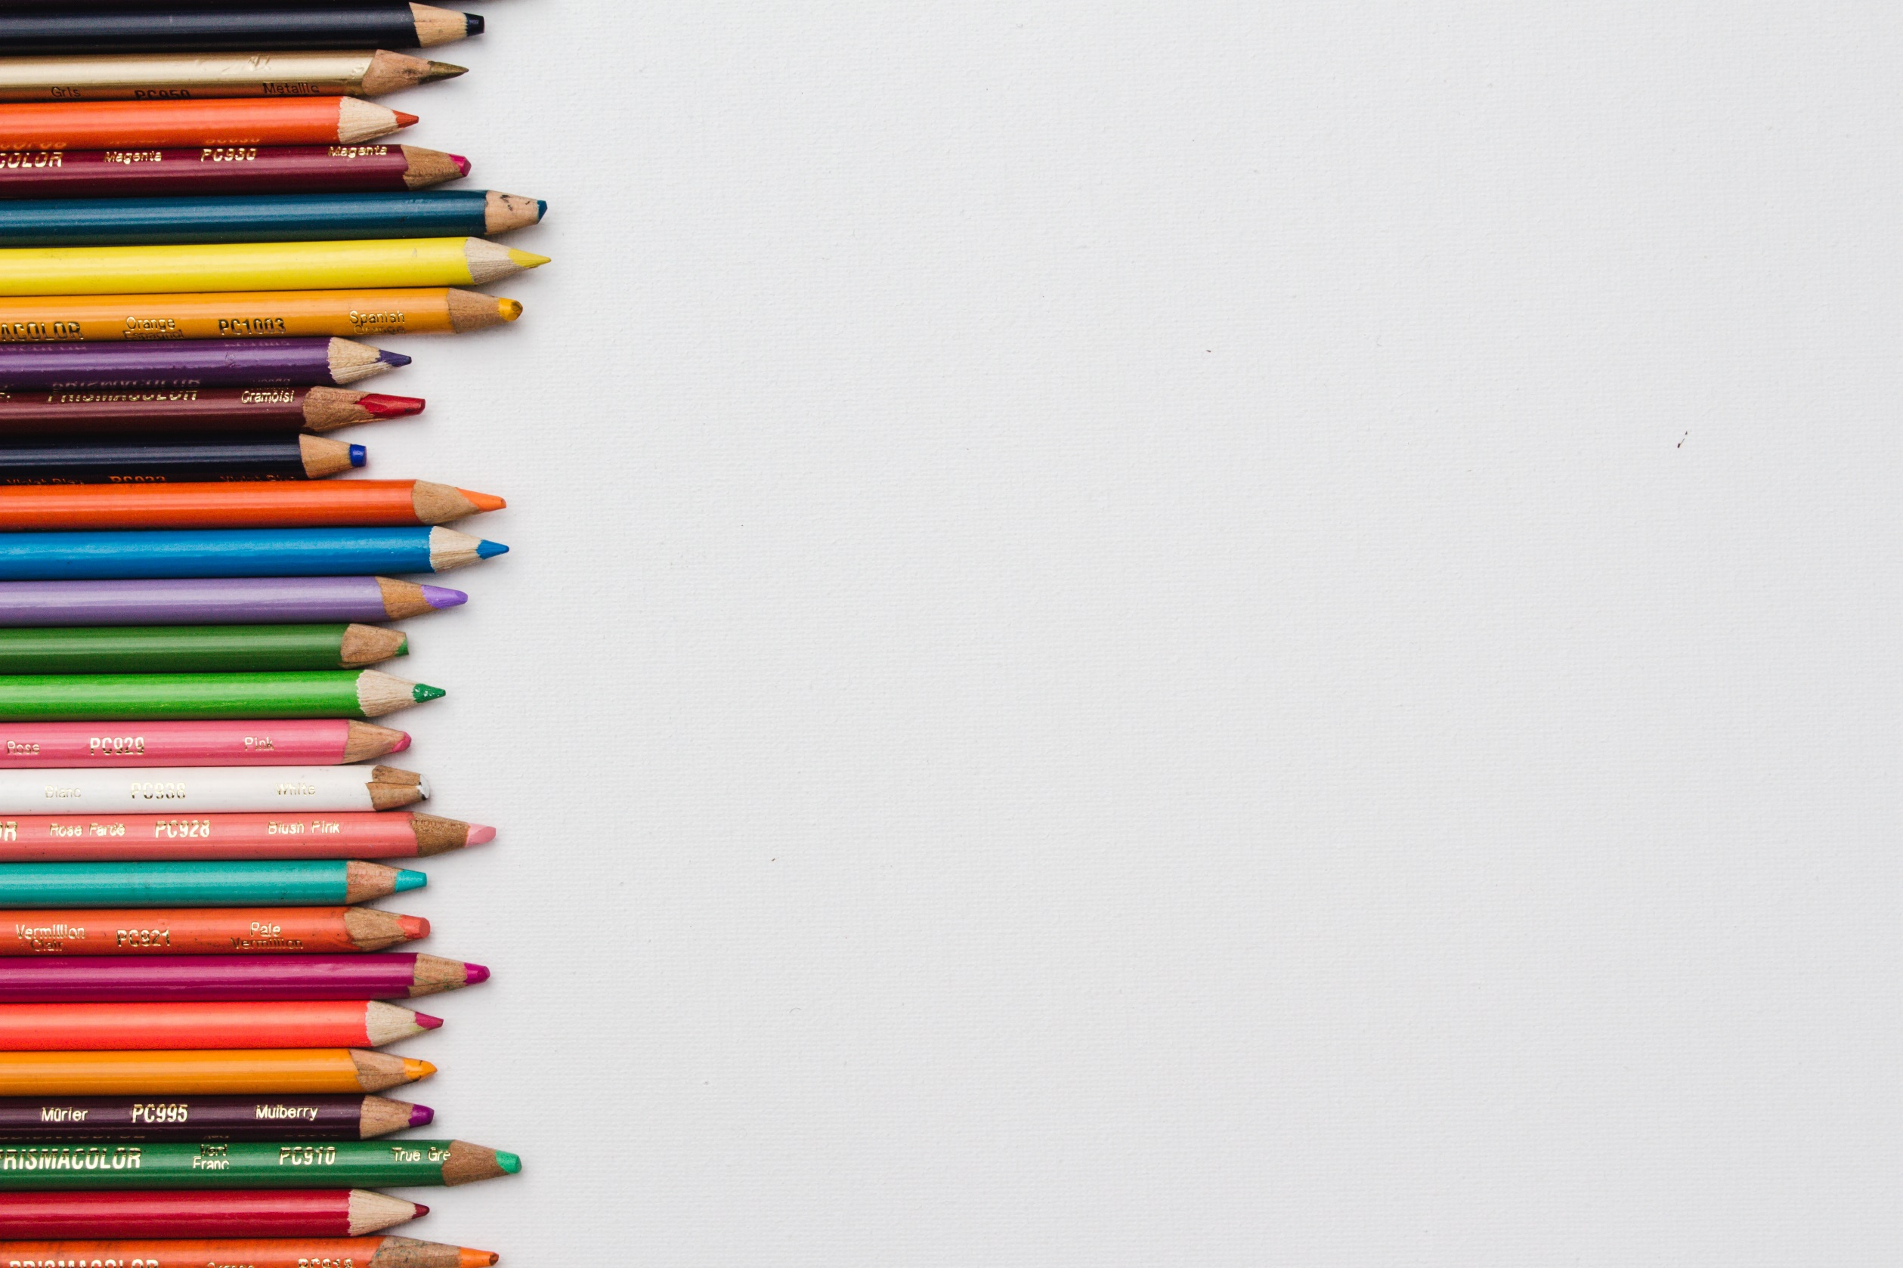
A message for the teacher
This presentation was designed to provide additional information to the teacher prior to beginning the activities of the Educational Kit.
It should be used as a reference guide to further explore the themes of the challenges addressed in the Educational Kit.
The PowerPoint presentation is designed specifically for teachers, but it can be used without any problems, in whole or in part, as visual support with the students.
Structure of the presentation:
Zero waste
The challenge … in the classroom

Slide 3
Refresher: understanding our waste
Before getting into zero waste, it is obviously necessary to understand why our waste production is problematic.
To do this, we encourage you to see or review the following presentation:
PowerPoint: Understanding our garbage – What is waste?

Slide 4
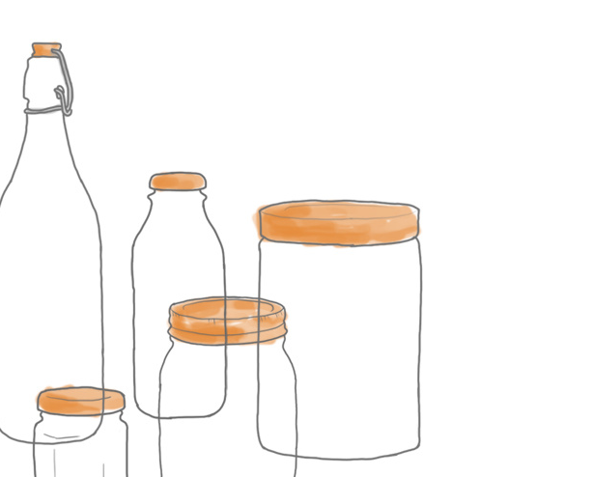
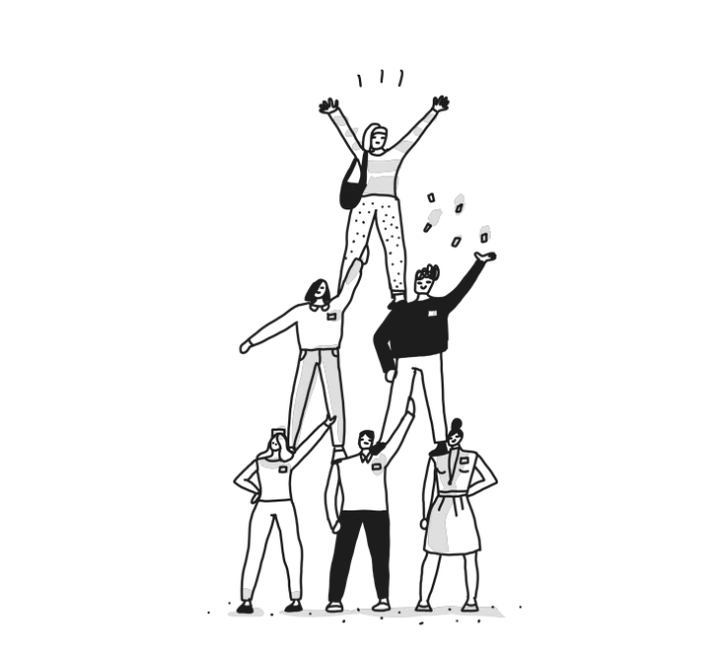
Zero waste
Zero waste is a movement that has only existed since the early 2000s in response to the phenomenal amount of waste and pollution produced by our society.
Zero waste proposes to go even further than simply properly sorting the materials that are consumed.
The movement proposes to consume differently and to adapt our way of life to the environmental realities in which we live.
As students, parents or teachers, we can all do a little something!
“We don’t need a handful of people doing zero waste perfectly. We need millions of people doing it imperfectly.”
- Anne-Marie Bonneau

Slide 5
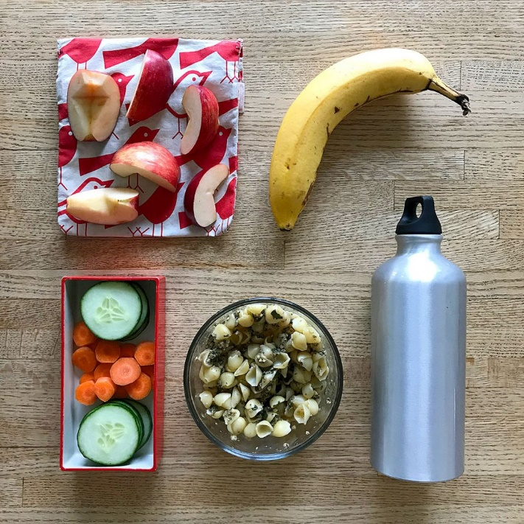
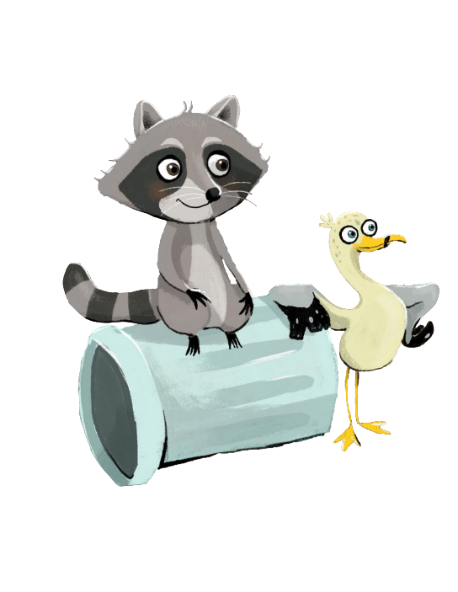
Zero waste
A clear vision:
A future without waste and toxic products.
Why?
Because waste increases the pressure on the environment and poses a risk to the vitality of our communities.
Goals:
Zero waste produced by individuals
No wasting of resources (energy, material and human)
Zero waste and pollution emission in the production and processing environment
No use of toxic products (in processes and products)
Making a zero waste lunch is easier than you think!

Slide 6
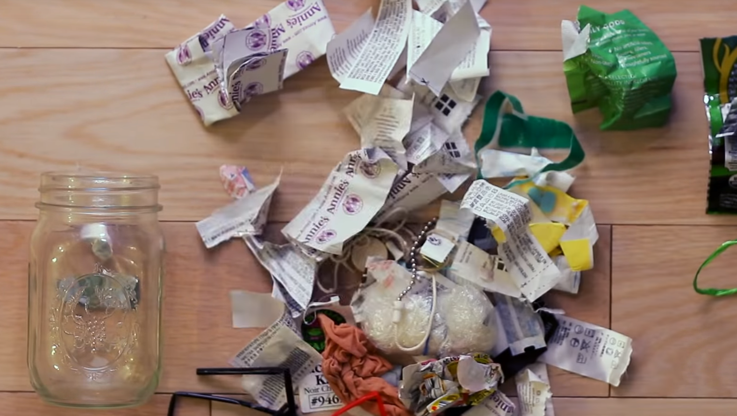
Aiming for “zero”!
Zero waste subscribers minimize their consumption and maximize the reuse and recycling of their waste.
“Zero” waste is an objective rather than an end. There are very few people who really manage to produce no waste.
However, many of them adopt behaviours that lean toward zero waste and succeed in considerably reducing their production of waste.
After one year, they have very little “final” waste!
Here, we see the “final waste” for a full year for one person…
…it fits into this little Mason jar!

Slide 7
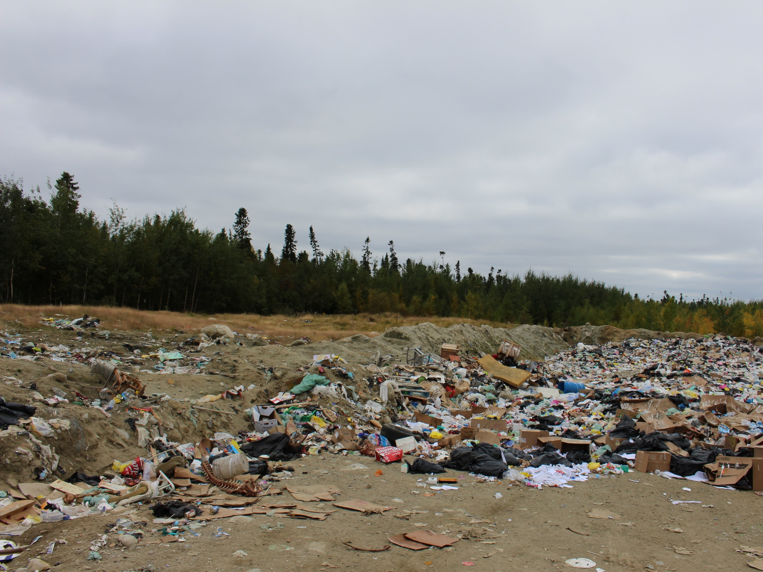
Way back when, the principle of zero waste did not exist… …because we did not need it!
For shelter, food, transportation and clothing, our ancestors used materials found in nature to make everything they needed.
When an object came to the end of its useful life, it returned to nature without leaving a trace. Our objects were biodegradable.
Today, we cannot do that anymore with our objects. Most are pollutants because they are composed of complex, synthetic and chemical materials. That's why now, we need recycling, ecocentres and composting! They allow us to waste nothing and respect Mother Earth despite our modern way of life!
You are quite right!
And you know what ? One thing is certain.
Today, just like yesterday…
…the best waste is the waste that is not produced.

Slide 8
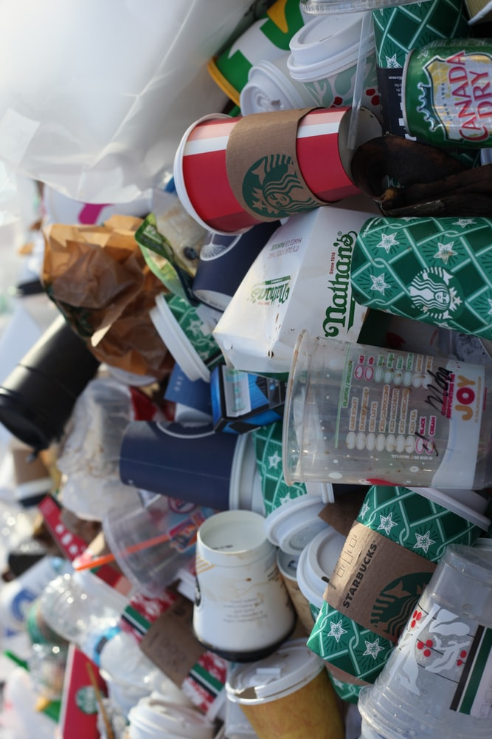
Human indifference is the biggest adversary for the health of our planet
How can you do your part?
Be aware of the problem and your individual impact
Reduce your waste production
Refuse – what you do not need
Reduce – your consumption
Reuse – what is in good condition
Repair – instead of throwing away
Recycle – to give a second life
Recover – and compost
Ask companies to produce more environmentally friendly products…
…to avoid all that is single use, disposable and composed of toxic products, and replace them with sustainable and long-lasting products.

Slide 9
Zero waste
According to the Association Québécoise du Zéro Déchet (AQZD)
Refuse
Say no to a much bigger impact than you can imagine! Say no to advertising in your mailbox, no to free samples, no to plastic bags, no to plastic or paper cups, etc.
Reduce
Buying for the sake of buying? Again, no! It's important to ask yourself questions when deciding to buy something. Do you really need it? Is it really necessary?
Reuse
Why not buy products that can be reused endlessly?
Repair
Repairing contributes to extending the life span of products and helps to reduce the consumption of resources and the production of waste.
Recycle
When you have garbage, it is important to be able to recycle the materials for reintegration into the production cycle.
Recover (compost)
Do not throw your organic waste in the trash! Learn about the composting solutions near you.

Slide 10
Zero waste… in the classroom!
Challenge # 2 on “zero waste” focuses on reducing the amount of waste found in the garbage cans of the classroom.
After collecting and weighing the classroom’s garbage, analyze what you have produced. What kind of waste is it? Groceries? Food? Packaging? Think about how you could reduce the amount of waste.
But what can we concretely do to reduce the waste produced in the classroom?
We have some ideas for you!

Slide 11
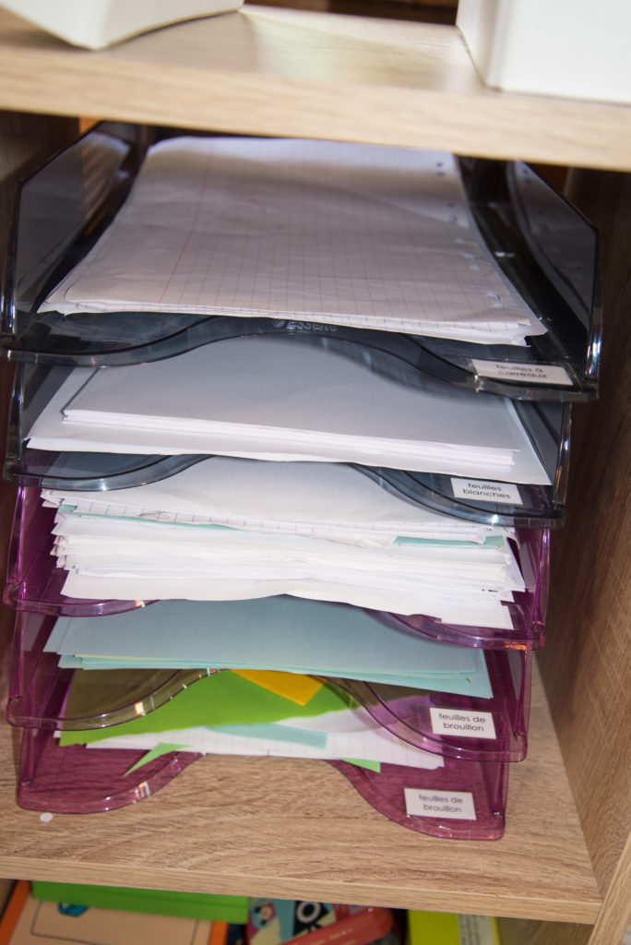
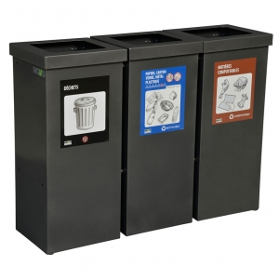
Zero waste… in the classroom!
Reusable cleaning materials (rags and refillable or homemade and non-toxic products)
If they are not already set up, let the school’s management know that you would like to have sorting stations (recycling and composting) in the school.
A used paper tray to reuse paper that is only used on one side!

Slide 12
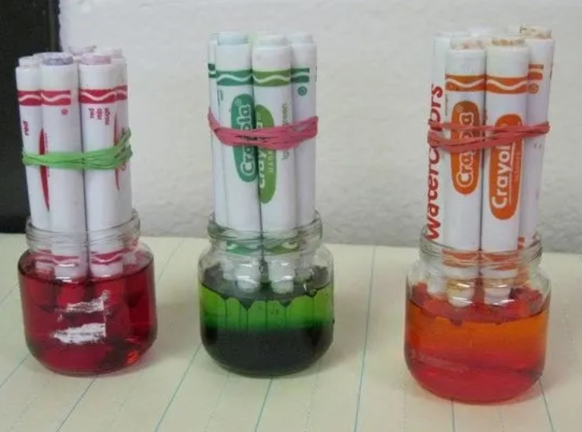
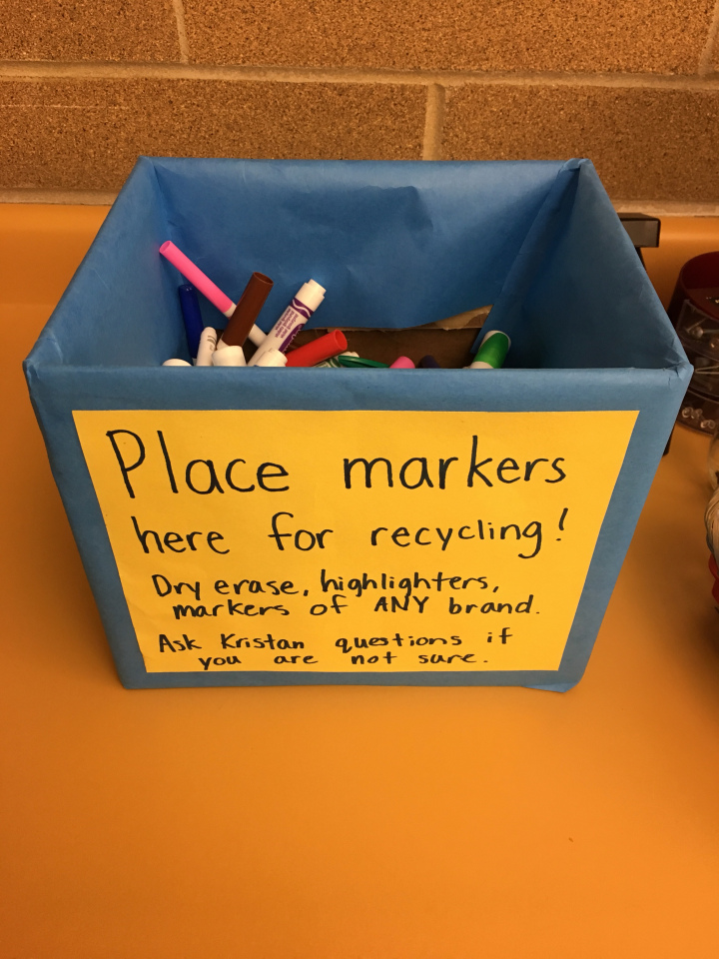
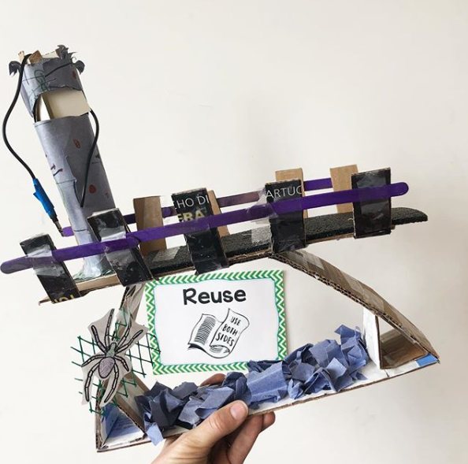
Zero waste… in the classroom!
Create your own dye for future arts and crafts projects!
For arts and crafts projects, use as many recycled materials as possible.
Ask your school to obtain a marker recovery box here.

Slide 13
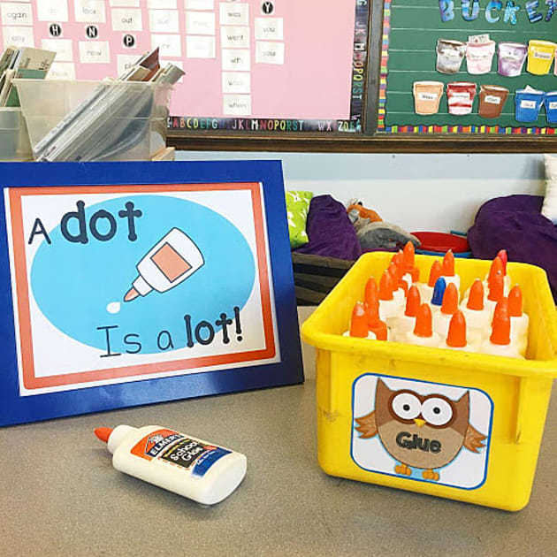
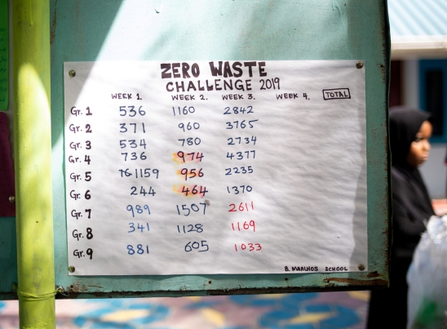
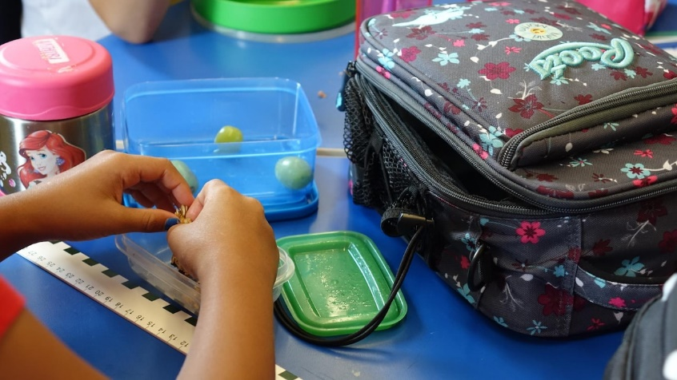
Zero waste… in the classroom!
Reuse small containers of liquid glue and refill them when empty (from a larger size).
Rate class performance (for challenge #2) by recording the weight of the waste.
Ask the students to do a “zero waste lunch” day during Challenge #2!

Slide 14
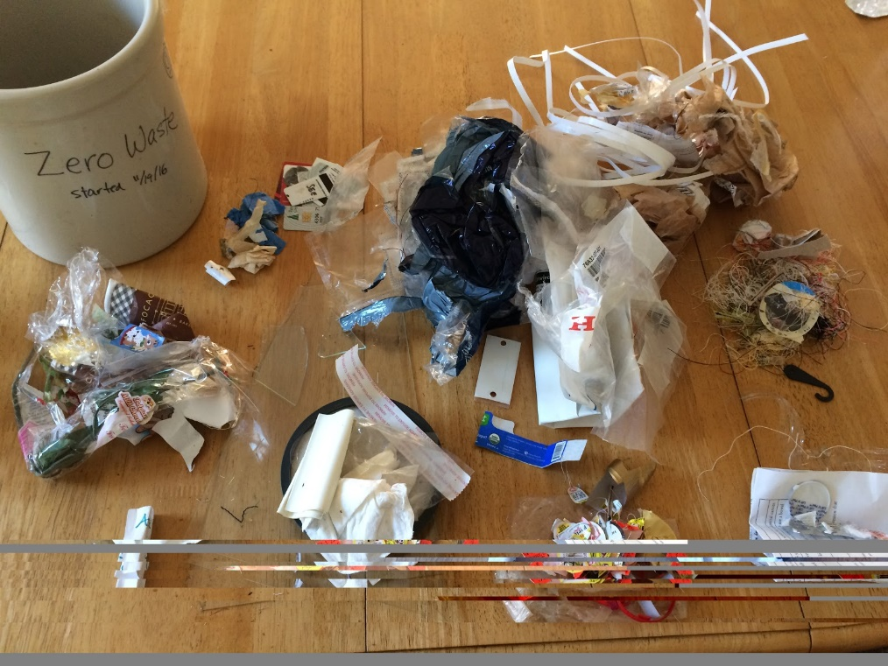
Zero waste… what a process!
Zero waste is a world without limits ... We are never completely finished, because we can always do something more!
Remember that the goal is not to be perfect. Add another little change each time you and your class are ready.
It's quite a journey and every gesture (even a small one) counts. In the end... an object only becomes waste when we decide to make it so.
Acting today is also about preserving the planet for tomorrow!
9 months of waste after completing a “zero waste” challenge with students (Rebecca Newburn)

Slide 15
Sorting properly, for starters!
The zero waste approach aims to reduce the production of waste at its roots to minimize our impact on the environment.
Challenge # 2 allows students to see how much waste is generated before and after the challenge, and how small things can really make a difference!
The other challenges of the Educational Kit also prepare you to deal with the problem at its roots: the way we consume and the way we manage our waste.
Challenge 1: Properly sorting our waste: Where does it go?
Challenge 2: Zero waste
Challenge 3: Household hazardous waste
Challenge 4: Composting
Challenge 5: My ecological footprint

