Slide 1
Household Hazardous Waste
Informative material intended for teachers
EDUCATIONAL KIT TO SAVE THE LAND | FNQLSDI

Slide 2
A message for the teacher
This presentation was designed to provide additional information to the teacher prior to beginning the activities of the Educational Kit.
It should be used as a reference guide to further explore the themes of the challenges addressed in the Educational Kit.
The PowerPoint presentation is designed specifically for teachers, but it can be used without any problems, in whole or in part, as visual support with the students.
Structure of the presentation:
Recognizing HHW
What to do with HHW
Properly disposing of HHW
Recovering HHW

Slide 3
Household Hazardous Waste
What is HHW?
HHW refers to the waste of many common hazardous household products.
These materials are sensitive to improper use, mixing, storage or disposal, which could damage health and the environment.
HHWs are identified with the 4 following symbols:
IMPORTANT
Some HHWs are not identified by any of these symbols! ALWAYS bring them to the ecocentre (e.g., lightbulbs).

Slide 4
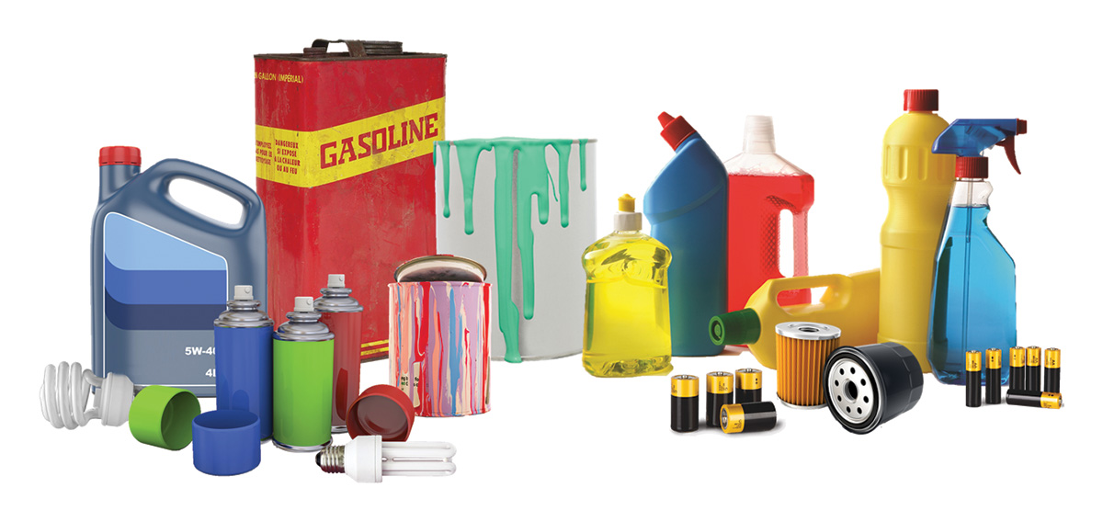
Household Hazardous Waste
These are products that we use every day!

Slide 5
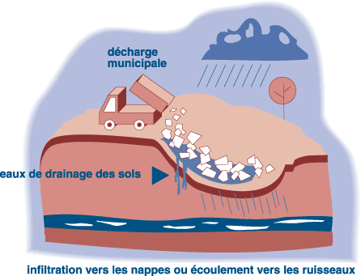
Why is it important to dispose of HHW responsibly?
Harmful for health and the environment
Contamination of soils and drinking water
Municipal discharge
Soil drainage water
UNSAFE WATER
DO NOT DRINK
Infiltration of fields or flow towards streams

Slide 6
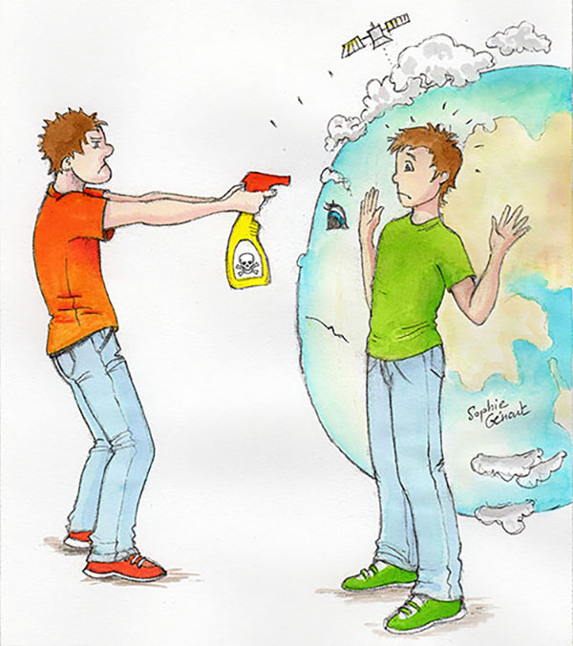
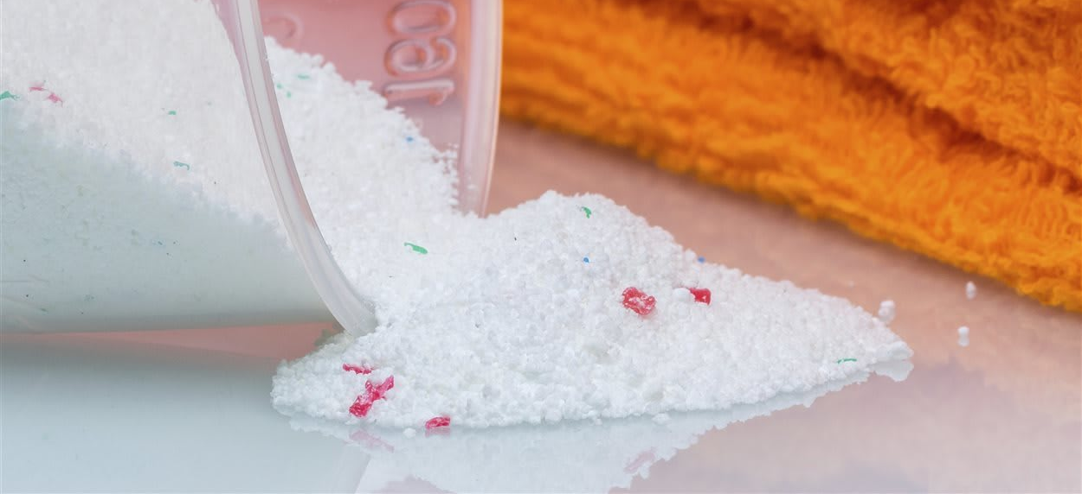
Why is it important to dispose of HHW responsibly?
Harmful for health and the environment
Increased air pollution and respiratory disorders (volatile organic compounds)
Les produits ménagers plus dangereux que prévu pour la santé et l’environnement
(Household products are more dangerous for the environment than anticipated)
Published on Friday, March 2, 2018 at 10:42 am
Updated on March 3, 2018 at 6:51 am

Slide 7
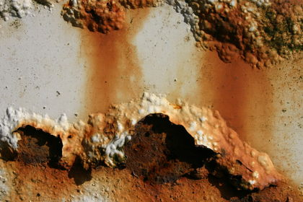
Corrosive HHW
A corrosive product burns the skin and eyes on contact and the digestive tract if swallowed. It can corrode materials.

Slide 8
Explosive HHW
The container may explode if heated or punctured and shards can cause serious injury.

Slide 9
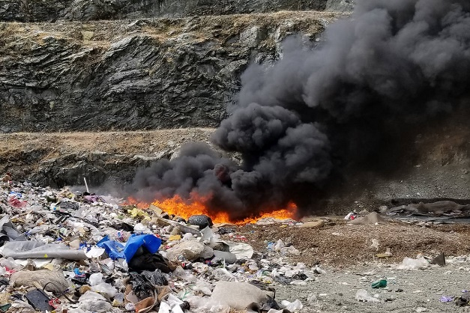
Flammable HHW
These products or the vapours they can release will ignite near a source of heat, flames or sparks.

Slide 10
Toxic HHW
If these products are swallowed, licked or sometimes touched or inhaled, they may cause discomfort or even death.

Slide 11
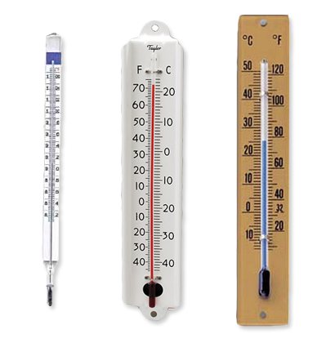
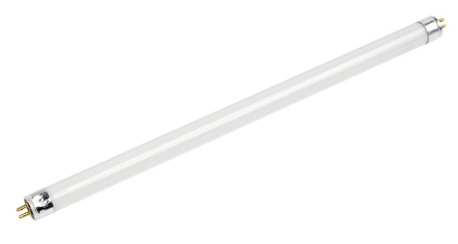
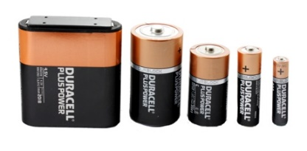
HHW in the home
Compact fluorescent lightbulbs
Fluorescent tubes
Thermometers
Batteries
Ink cartridges
Electronic products

Slide 12
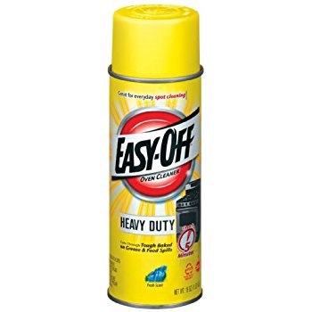
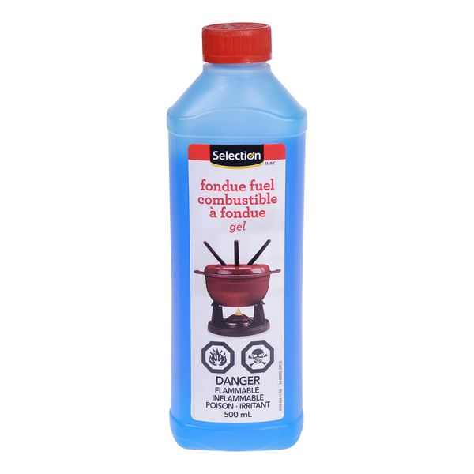
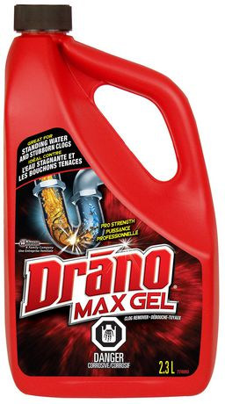
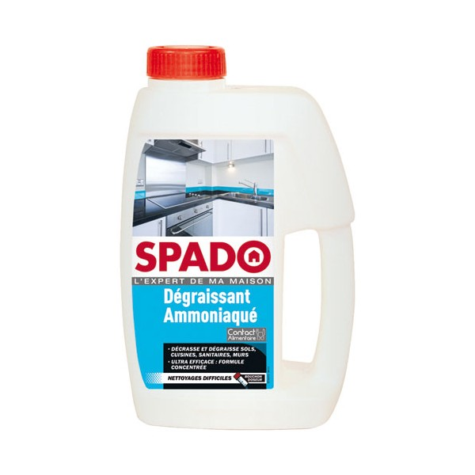
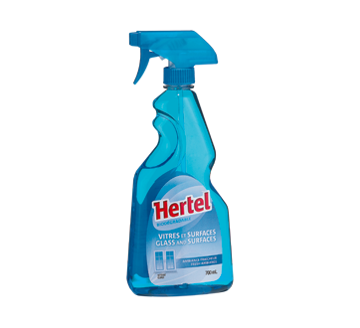
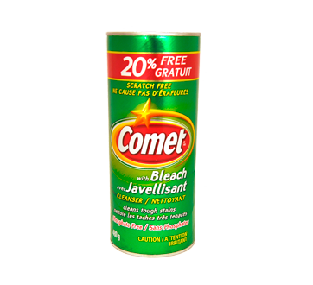
HHW in the kitchen
Oven cleaner
Fondue fuel
Liquid clog remover
Window cleaner
Scouring powder
Ammonia

Slide 13
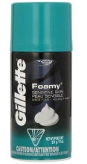
HHW in the bathroom
Pharmaceuticals
Rubbing alcohol
Toilet cleaner
Hairspray
Hair dyes
Depilatory cream
Nail polish and remover
Aerosol shaving cream

Slide 14
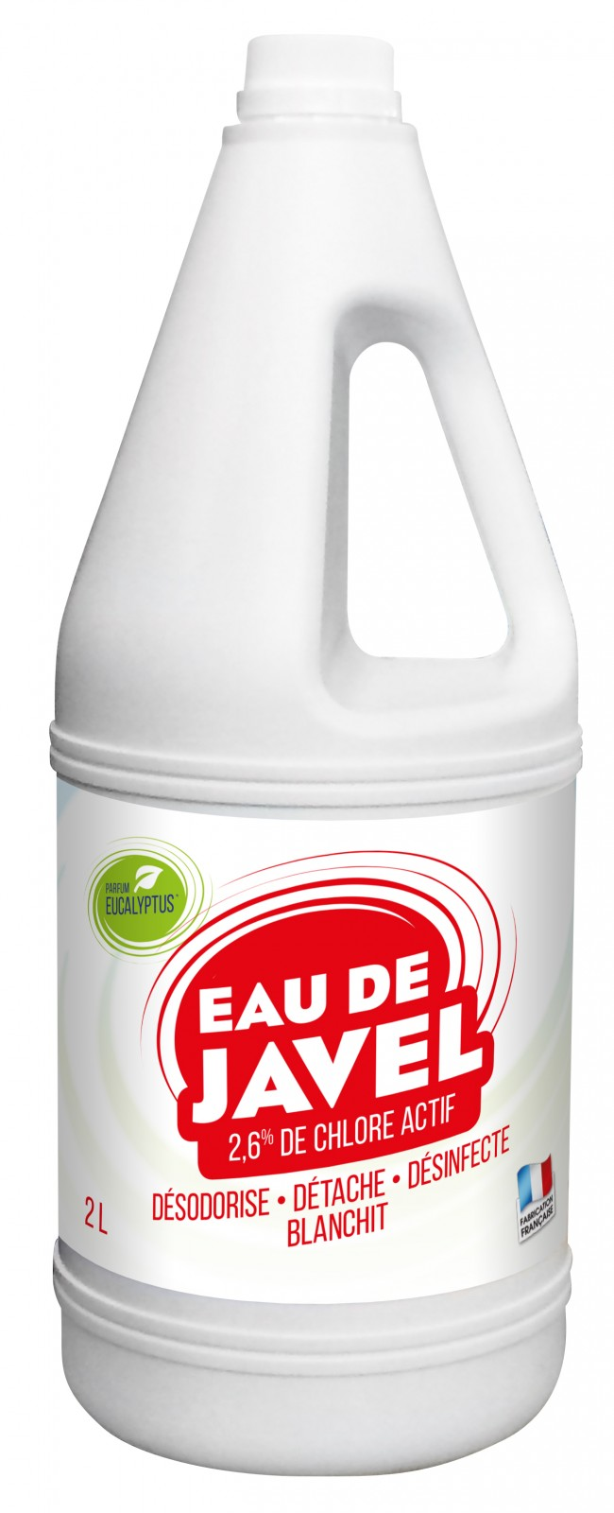
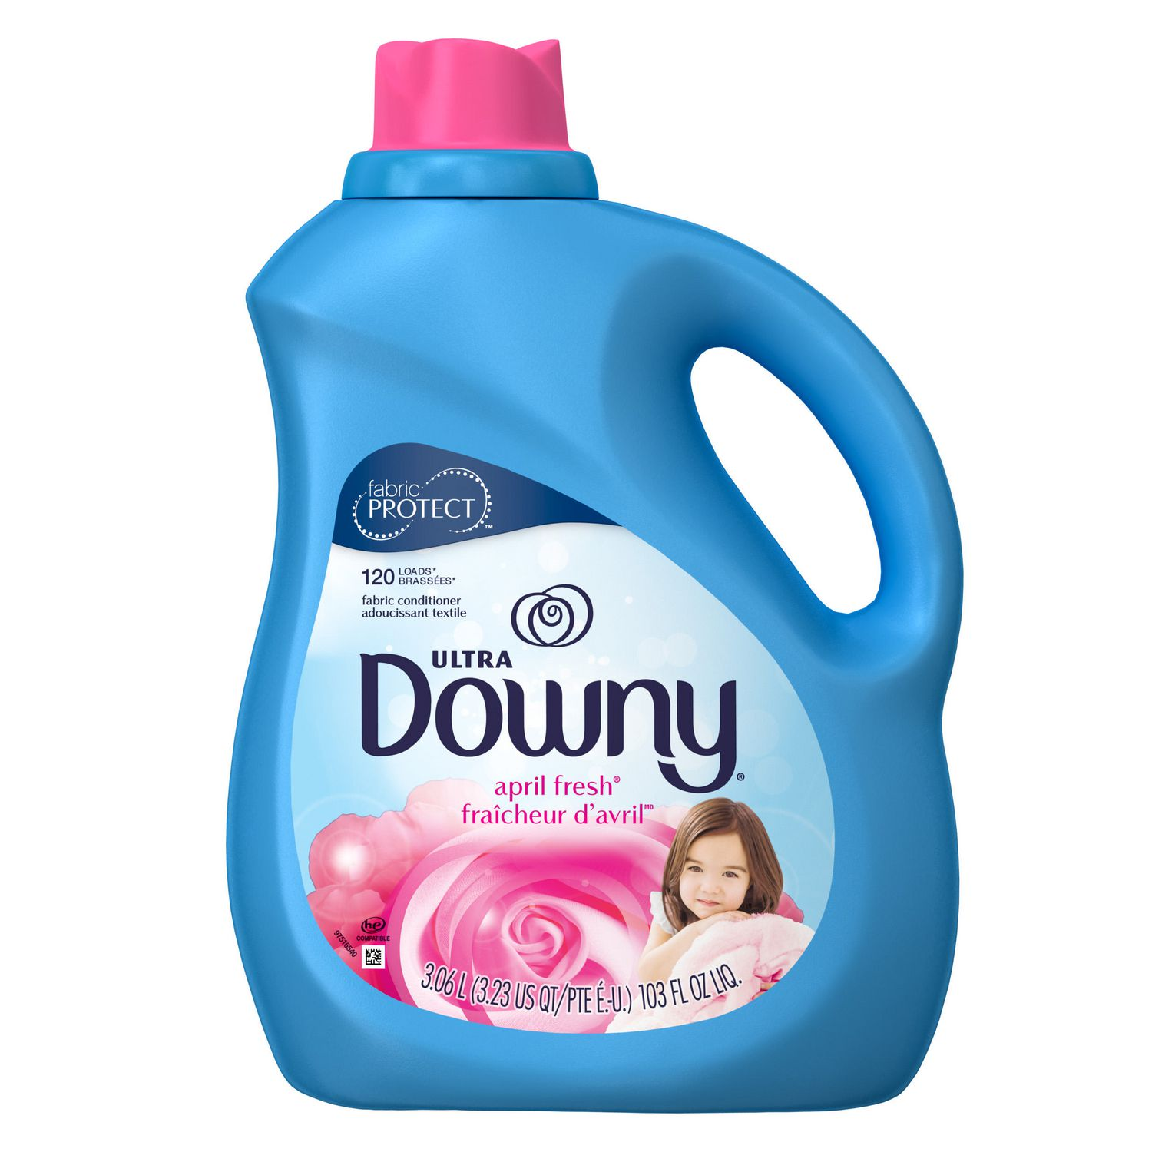
HHW in the laundry room
Bleach
Fabric softener
Stain remover
Detergent

Slide 15
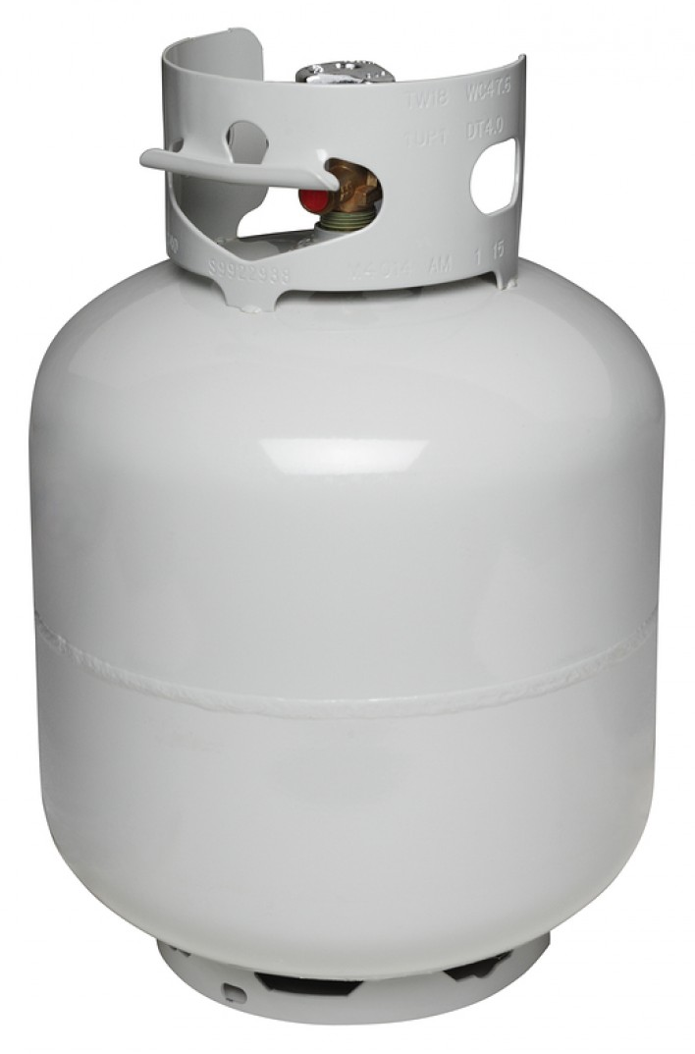
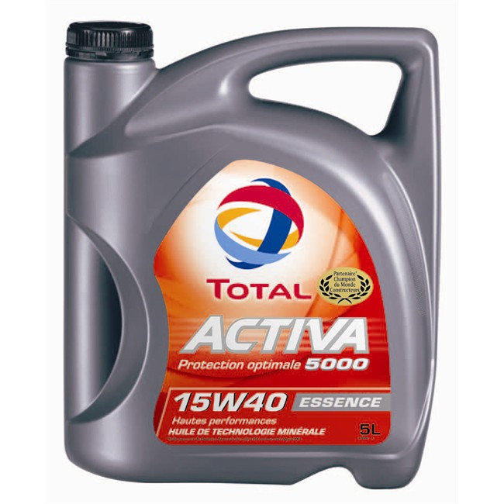
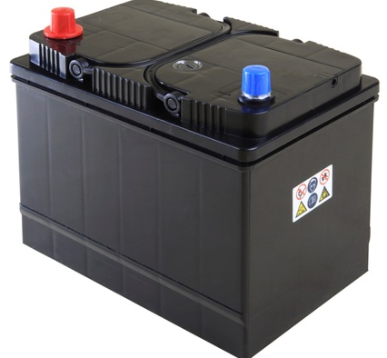
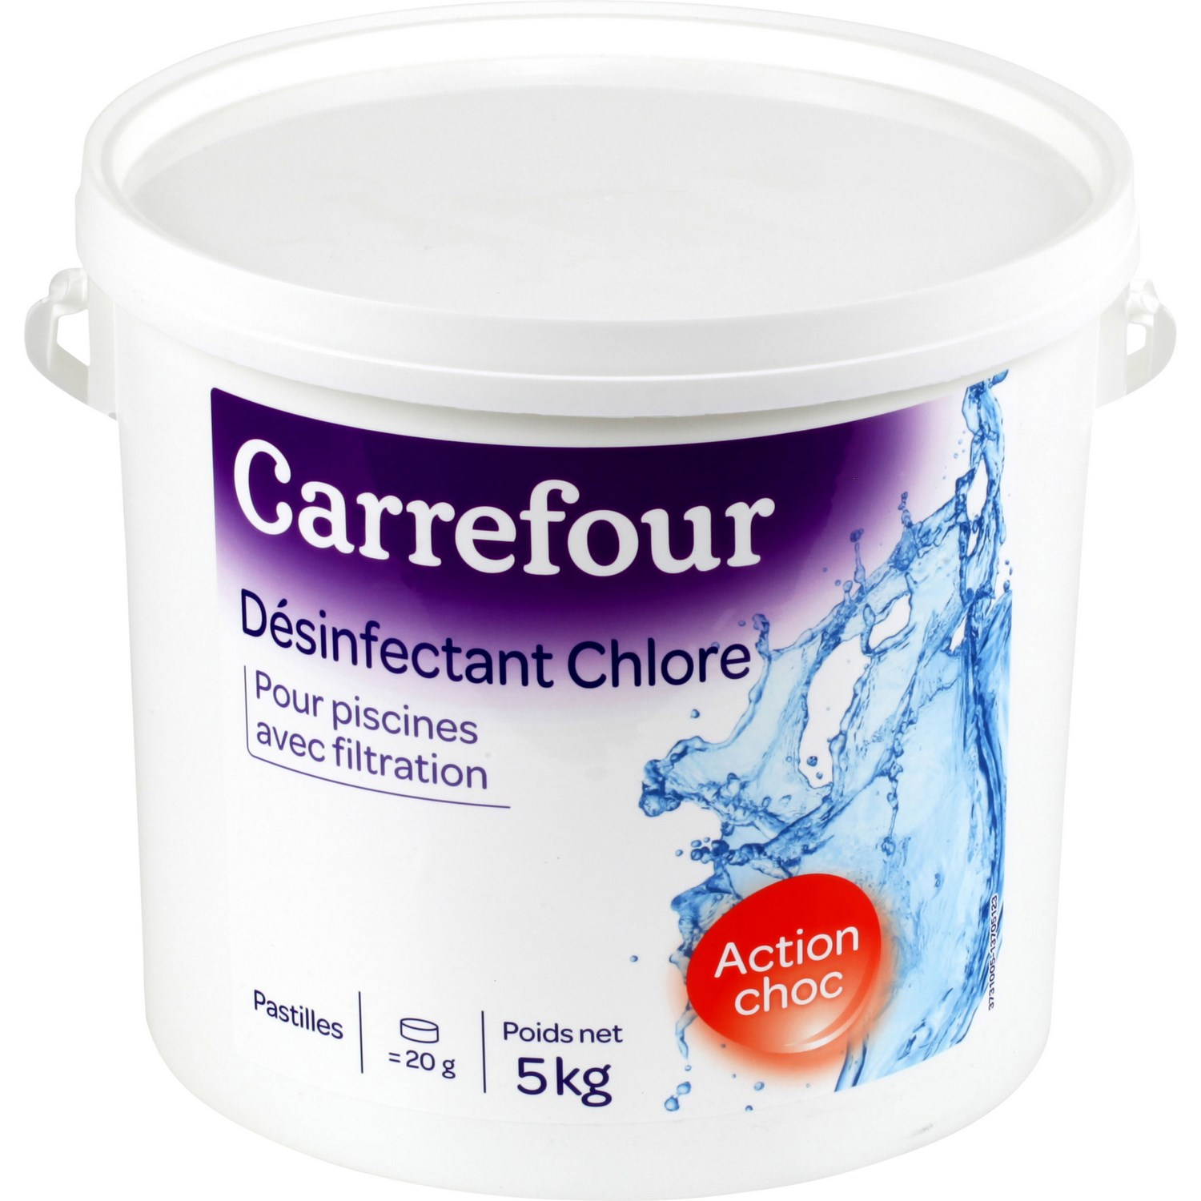
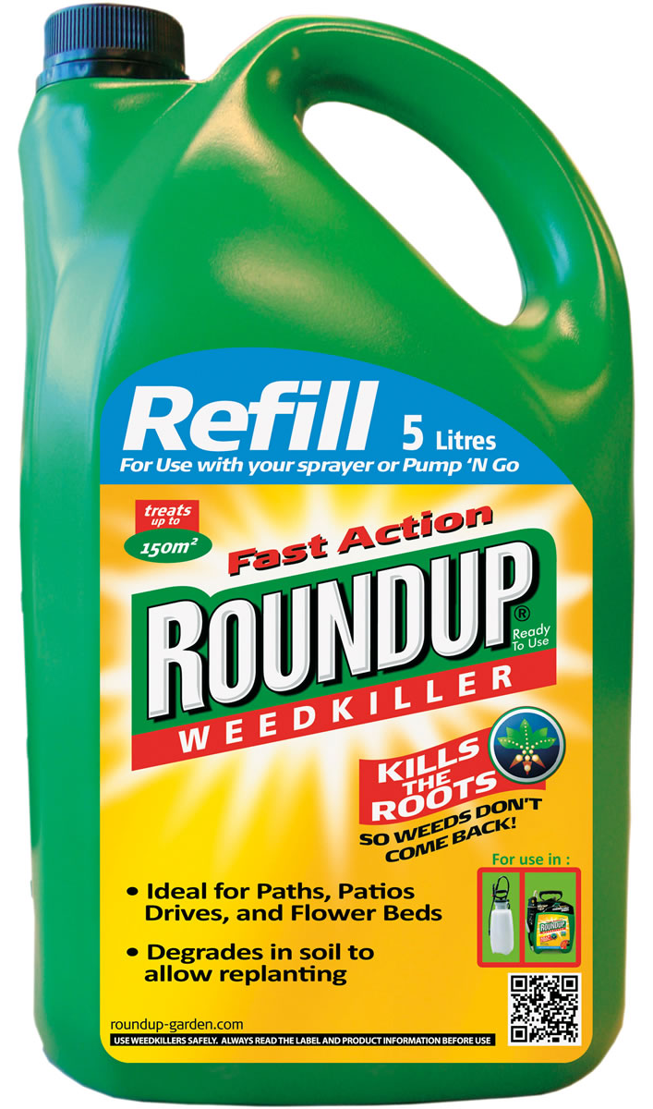
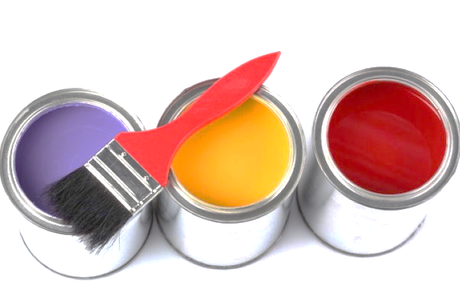
HHW in the garage
Used oils and filters
Car batteries
Antifreeze
Rust protector
Fuel/Diesel
Propane
Aerosols
Pool products
Pesticides/insecticides
Chemical fertilizer
Fire extinguishers
Solvent-based glue
Remover, paint, stain, varnish

Slide 16
Extended Producer Responsibility (EPR)
According to Recyc-Québec, the Extended Producer Responsibility (EPR) is a principle according to which companies that put products on the market in Quebec are responsible for their end-of-life management by establishing a program for the recycling or recovery of the product or by partnering with a recognized management organization.
Organization
EPRA-Quebec
Products
Computers, monitors, televisions, telephones, printers, fax machines, cameras, audio and video devices, etc.
Organization
Recycfluo
Products
Fluorescent tubes, compact fluorescent lamps, other types of mercury-containing lamps
Organization
Eco-Peinture
Products
Paints, stains, varnishes, finishes, lacquers and protective coatings with latex, alkyd or enamel, all their containers
Organization
Call2Recycle
Products
Rechargeable batteries, non-rechargeable batteries
Organization
SOGHU
Products
Oils, their containers and filters, antifreezes, coolants, brake cleaner containers

Slide 17
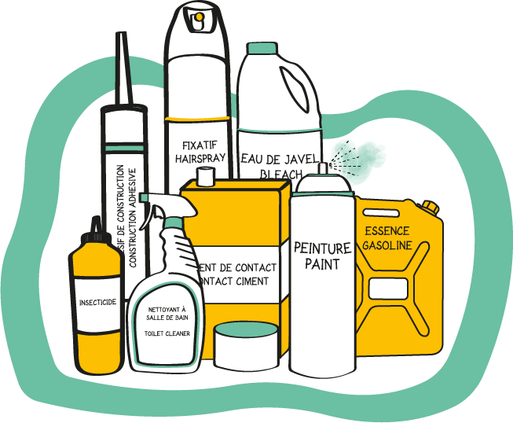
What to do with HHW… …in 3 easy steps!
1. Recognize them
Does the product have a hazardous product logo?
Is it composed of chemical or toxic products?
Is it a pharmaceutical?
2. Store them
Keep the original container tightly closed and properly identified
Keep in a dry, cool, ventilated area away from sources of heat
Keep out of reach of young children or animals
3. Dispose of it properly
Always in their original container (otherwise, clearly identify the contents), bring the products to the ecocentre
If the ecocentre does not accept it, find another drop-off point:
www.onenprendsoin.recyc-quebec.qc.ca

Slide 18
What to do with HHW? You have to be careful!
It can cause discomfort or death!
It can burn the skin, eyes and digestive tract!
It can explode!
It can catch on fire!

Slide 19
What to do with HHW? Safety measures
If inhaled
Breath fresh air
If swallowed
Poison Control Centre: 1-800-463-5060
Product label
In case of skin contact
Rinse for 20 minutes with lukewarm/cold water
Remove jewelry and clothing from the affected area
Notes:
Inhalation
Chemicals and dust can be volatile and cause toxic fumes. If the slightest odour is detected, wearing a mask is mandatory. This person must breathe fresh air. If discomfort persists, going to the hospital is necessary.
Ingestion Call the Poison Control Centre as it may be dangerous to drink or induce vomiting (corrosive effect or chemical pneumonia).
Absorption
If a large area of ​​the body is contaminated with a hazardous product or products, clothing must be removed and the affected area rinsed with cold water for 20 minutes. You must never use ointments, creams or lotions. As soon as possible, see a doctor.
If splashing affects only a small area of ​​the skin, rinse thoroughly with cold water and then with soapy water. If afterwards a skin reaction is observed, see a doctor.
In case of contact with the eyes, rinse immediately with water for at least 20 minutes.
Never wear contact lenses, because in case of contact with the eyes, the lens may stick to the eye.

Slide 20
Properly disposing of HHW
Generally-speaking, HHWs go to the ecocentre. But beware, not all of them do!
Here are some examples of products that do not go to the ecocentre, and where to bring them.
Pharmacy or health centre
Police service

Slide 21
Properly disposing of HHW
In general, they go to your ecocentre
Check with your nearest ecocentre to find out if these materials are accepted.
For EPR products (electronics, lightbulbs, paint, batteries and used oils)
Ecocentre (inquire)
Other official EPR drop-off sites
Electronics
Bulbs
Paints
Batteries
Used oil
Other specific products
Pharmaceuticals: pharmacy or health centre
Firearms and ammunition: police service
Explosives (fireworks): police service

Slide 22
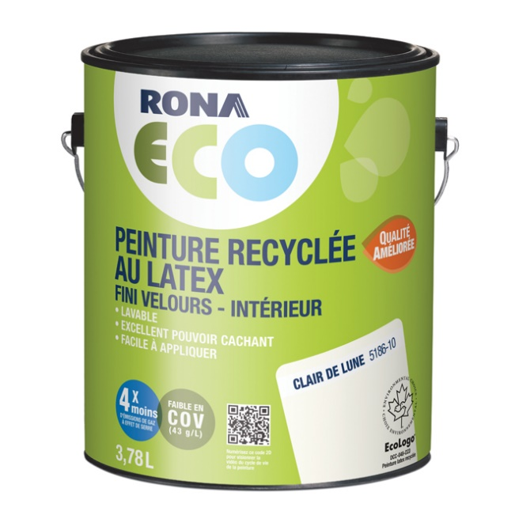
And after?
Household hazardous wastes, once brought to the right place, are recovered and treated by specialists.
Two outlets are available to them:
1. They are recovered in whole or in part, then reintegrated into the production chain!

Slide 23
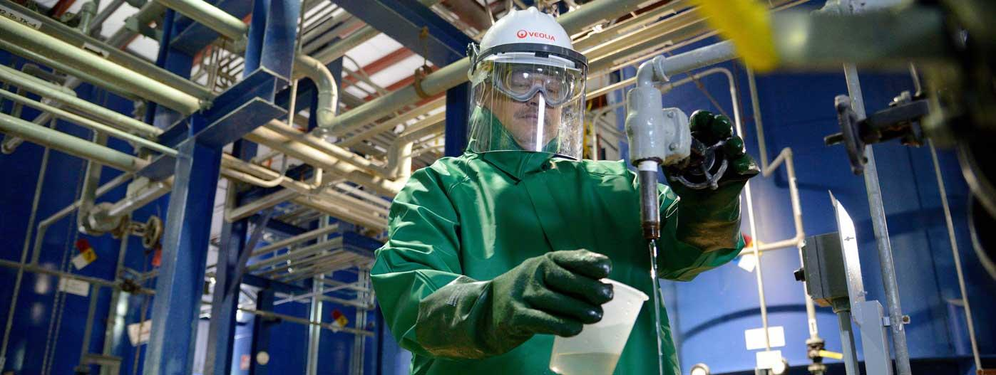
And after?
Household hazardous wastes, once brought to the right place, are recovered and treated by specialists.
Two outlets are available to them:
2. Hazardous products that cannot be recycled are treated to be neutralized and are eliminated without the risk of environmental contamination.

Slide 24
Products to recognize…
Household hazardous waste represents a very small portion of our waste but poses a very high risk to the environment. We have to be extremely careful with these products when we use them, but also when we want to dispose of them.
Do not forget, every object has its place!
The other challenges of the Educational Kit also prepare you to deal with the problem at its roots: the way we consume and the way we manage our waste.
Challenge 1: Properly sorting our waste: Where does it go?
Challenge 2: Zero waste
Challenge 3: Household hazardous waste
Challenge 4: Composting
Challenge 5: My ecological footprint

