Slide 1
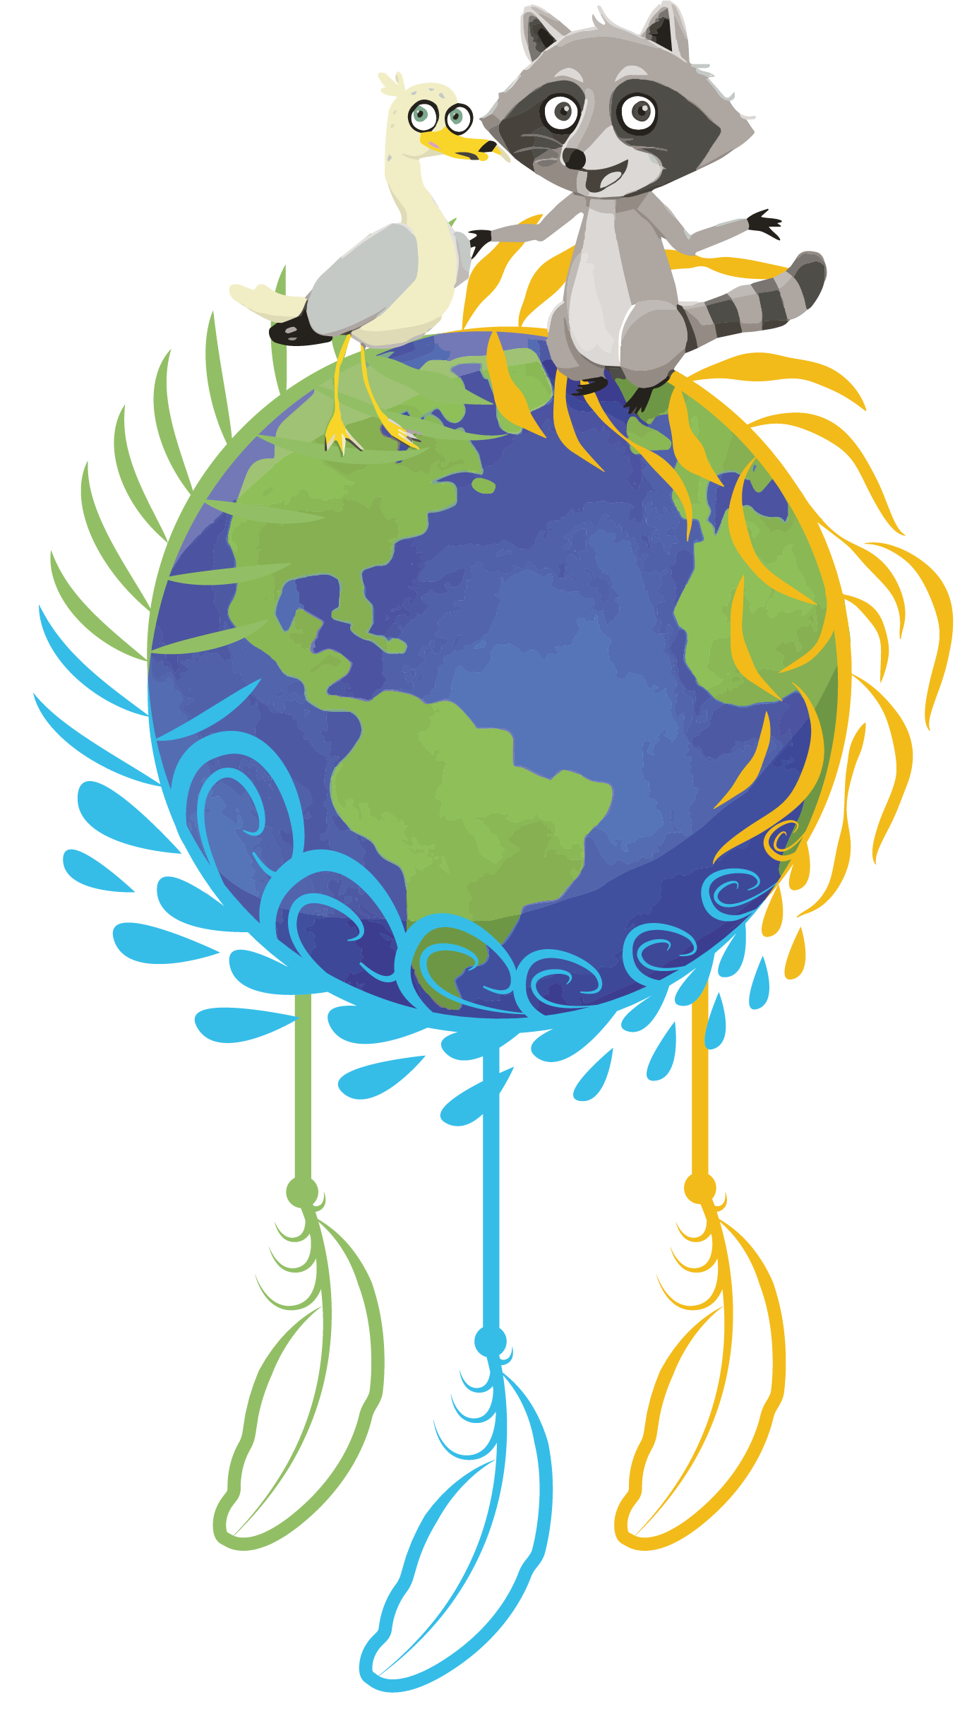
My ecological footprint: How can it be reduced?
Informative material intended for teachers
EDUCATIONAL KIT TO SAVE THE LAND | FNQLSDI

Slide 2
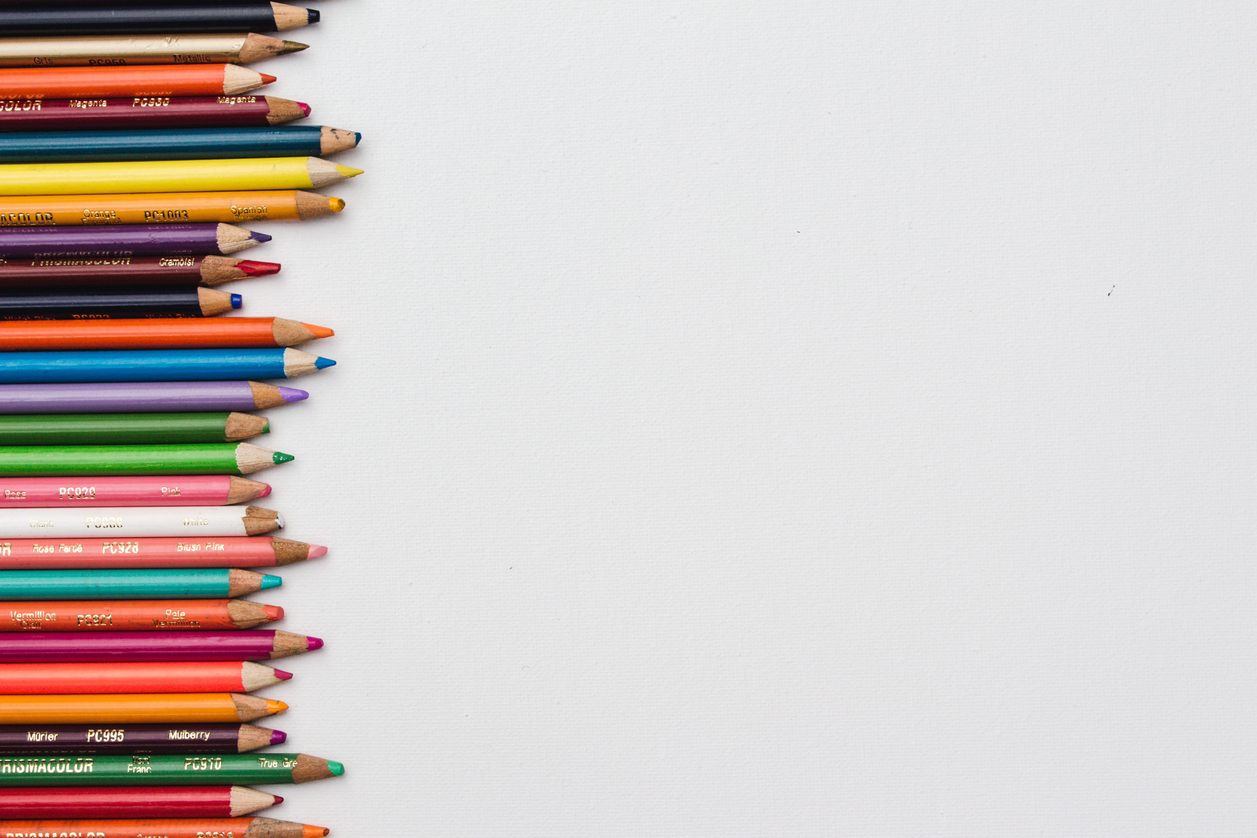
A message for the teacher
This presentation was designed to provide additional information to the teacher prior to beginning the activities of the Educational Kit.
It should be used as a reference guide to further explore the themes of the challenges addressed in the Educational Kit.
The PowerPoint presentation is designed specifically for teachers, but it can be used without any problems, in whole or in part, as visual support with the students.
Structure of the presentation:
Overconsumption
The waste hidden behind our purchases
The ecological footprint
Solutions to reduce your footprint!

Slide 3
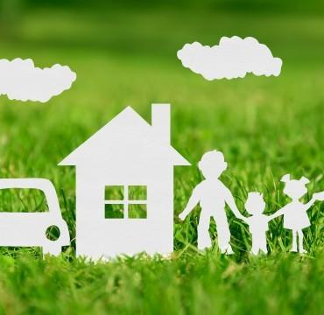
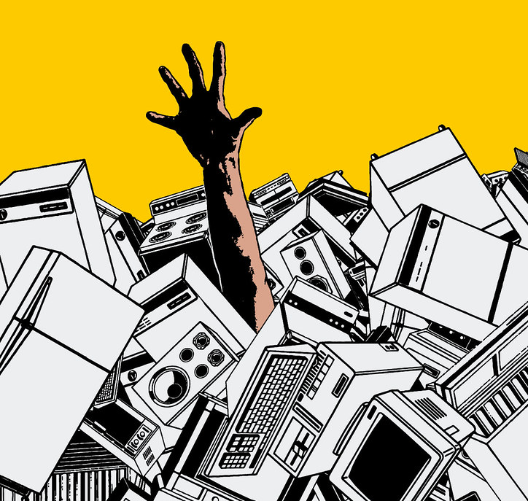
Consuming and overconsuming:
what is the difference?
Consuming is part of life.
We have basic needs that must be met: food, clothing, shelter, transportation, entertainment, education, and so on. Even our ancestors were consuming!
But our way of life has changed. Today, to meet these essential needs, there are enterprises, companies and manufacturers who offer different services and products. Consuming is therefore not bad in itself. The problem is overconsumption.
How do we come to overconsume?
(Have the students think about this question.)

Slide 4
Advertisements

Slide 5
What is this?

Slide 7
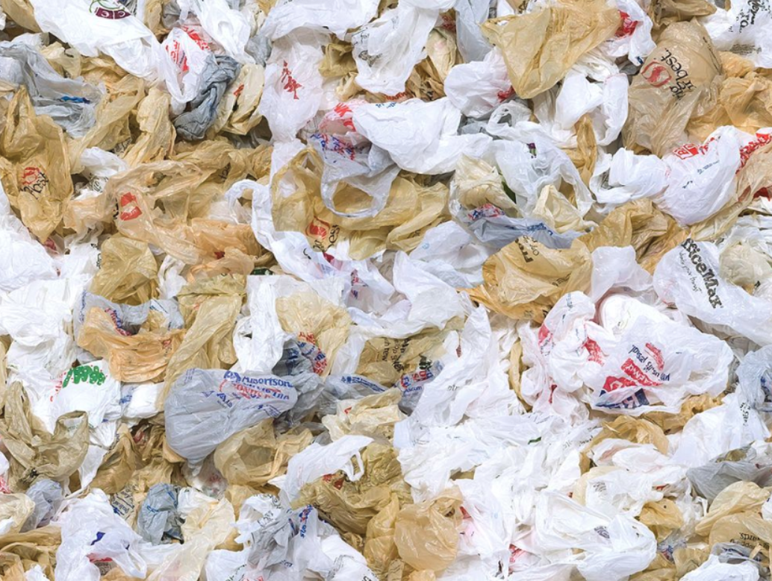
60,000 plastic bags are thrown away every 5 seconds (U.S.A.)

Slide 8
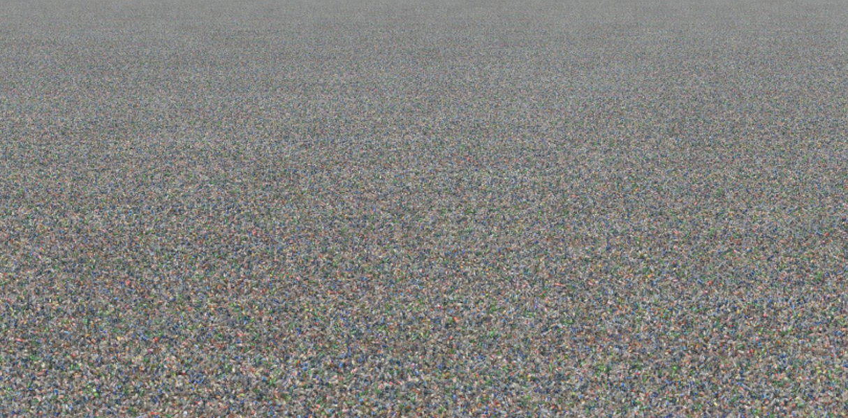
What is this?

Slide 9
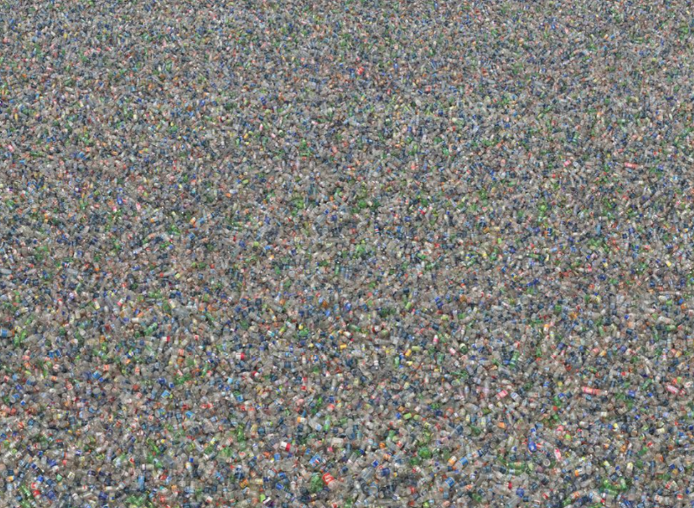

Slide 10
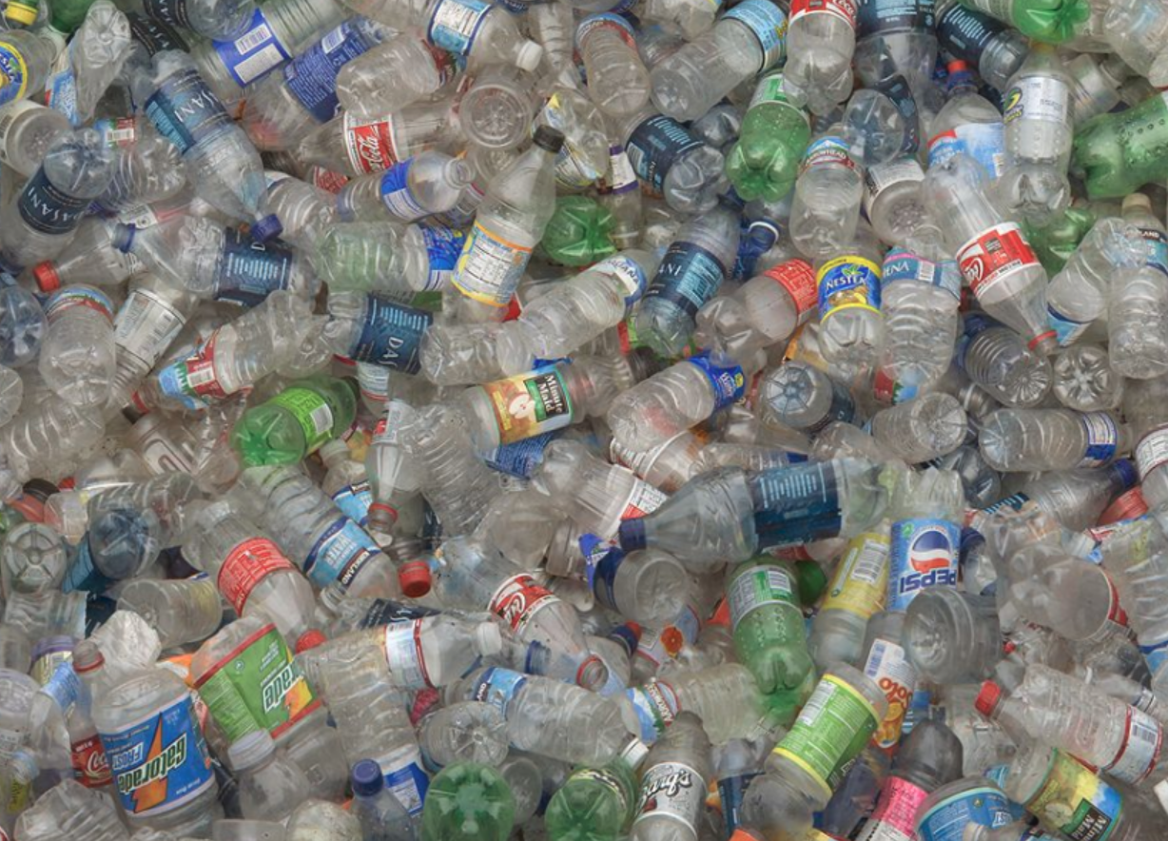
6,600 plastic bottles are used every second (U.S.A.)

Slide 11
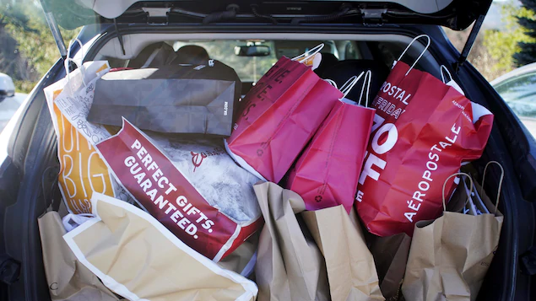
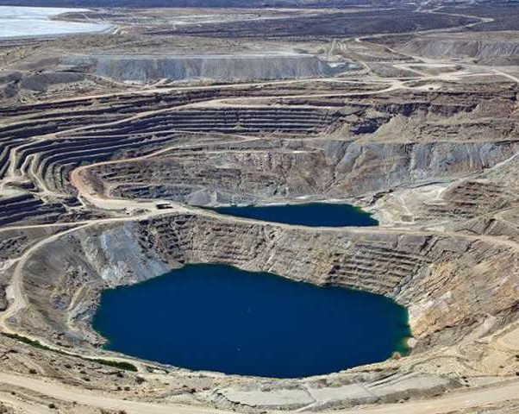
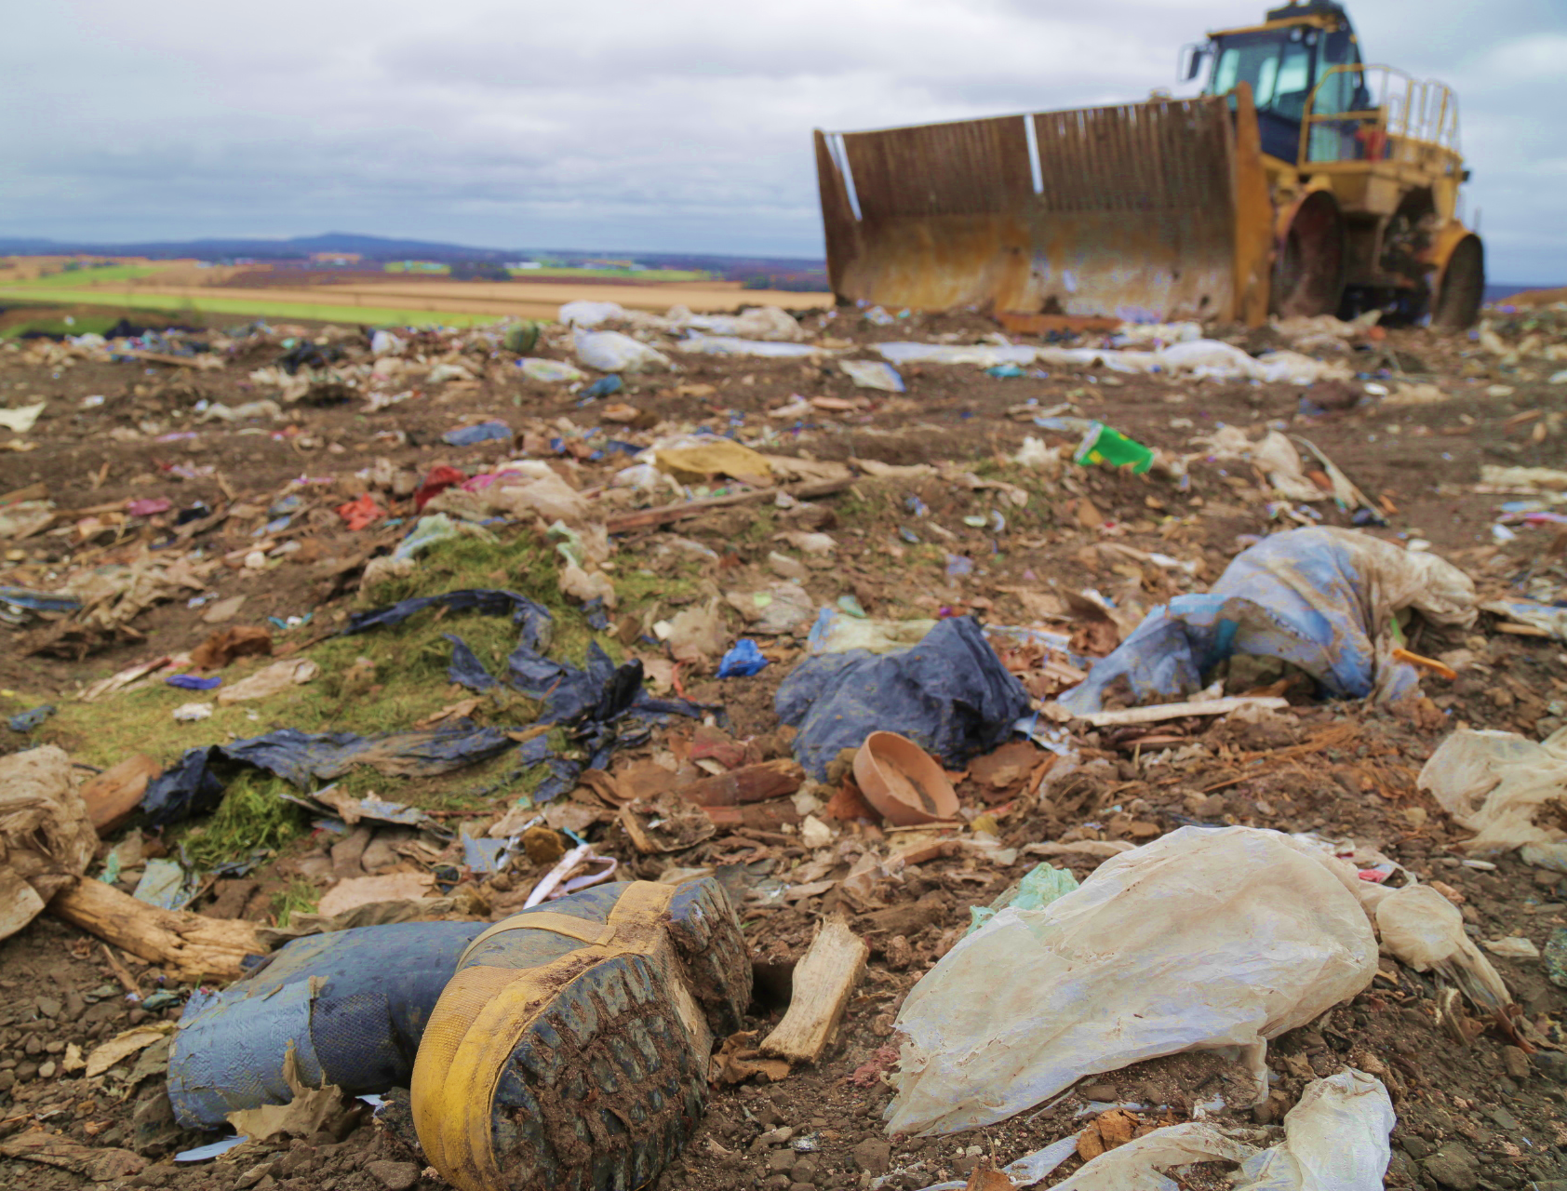
Overconsumption,
why is it bad?
Currently, billions of goods are produced every day in the world. Natural resources are used and wasted (wood, water, etc.) and large quantities of pollutants are released into the air, water and soil.
We produce much more waste than if we were only to consume to meet our needs. Throughout the life of a product, including extraction, processing, manufacturing and transportation to your home, the object leaves a huge ecological footprint in its path.
In addition, at the end of their lives, these objects generally end up in our landfills, which creates a lot of very harmful pollution for our planet.

Slide 12
Pollution and waste
produced by a coat
As for me, to avoid all that, I asked my cousin to give me his coat once it becomes too small for him!
1. Extraction of raw materials
(oil, mineral, cotton, sheep’s wool, water)
2. Processing of materials
(polyester, plastics, dyes, iron, fabric, wool)
3. Product distribution
(transport by truck or ship, packaging)
4. Use
(washing, repair)
5. End of life
(decomposition at the landfill)
OVERCONSUMPTION OF RESOURCES
WASTING, POLLUTION AND GARBAGE

Slide 13
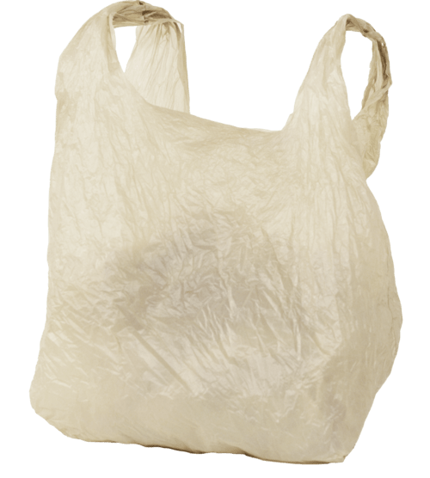
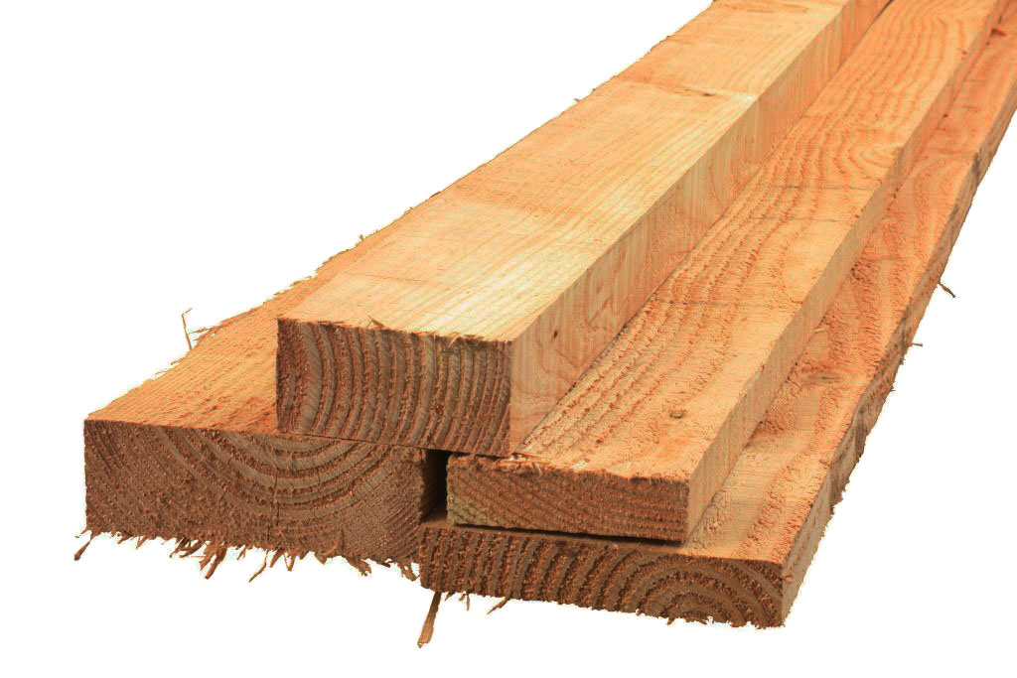
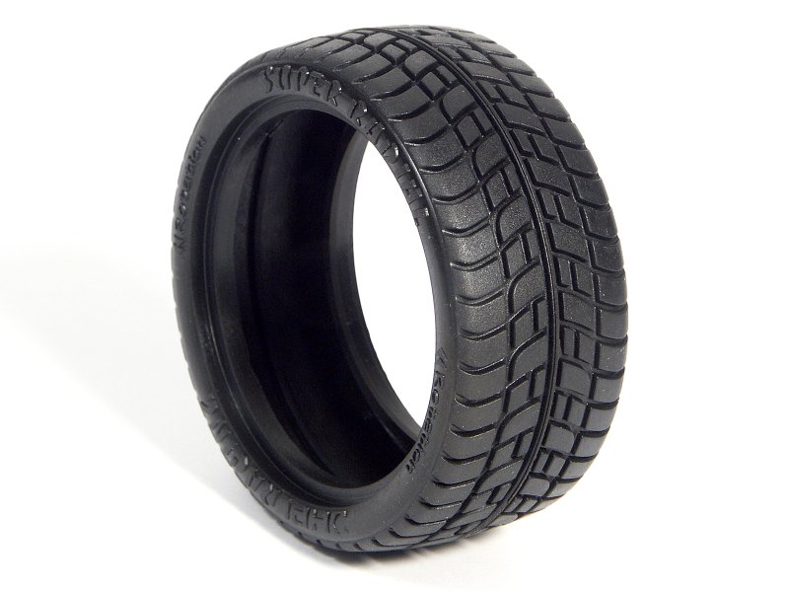
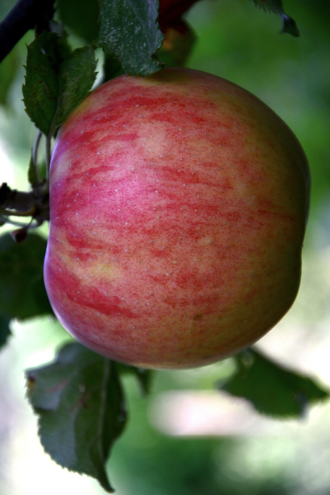
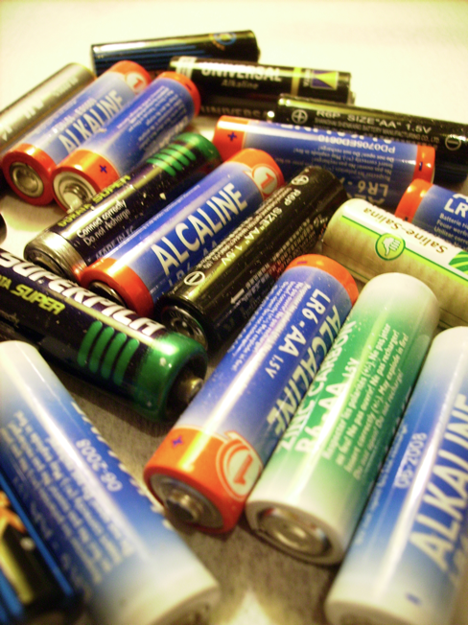
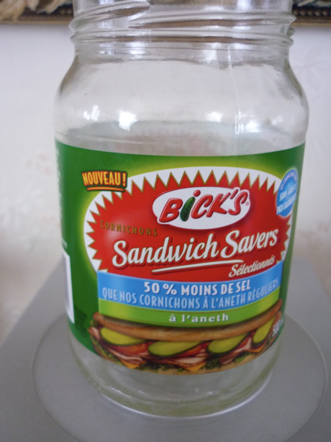
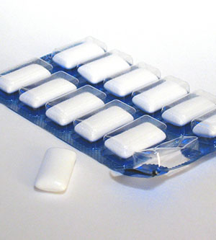
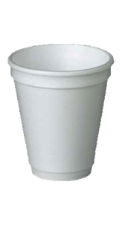
Life span of waste
Very short
Very long
3 MONTHS
6 MONTHS
1 YEAR
5 YEARS
50 YEARS
100 YEARS
500 YEARS
1000 YEARS
5000 +

Slide 14
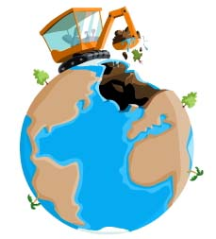
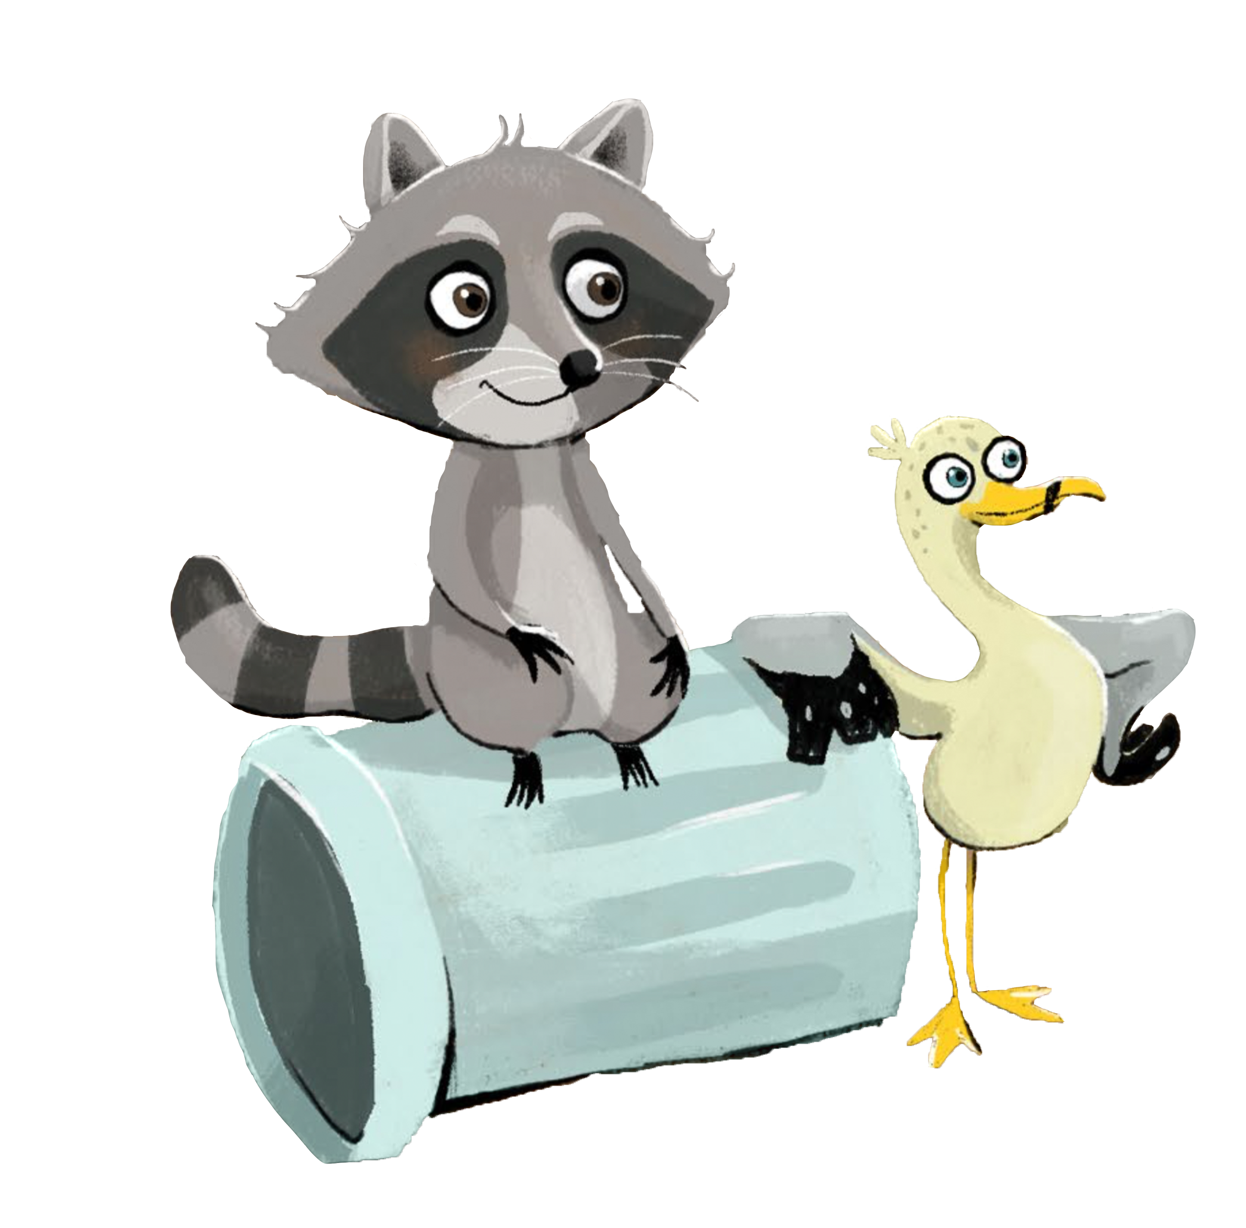
Consuming better, and less!
In the end, behind every purchase and every consumption there is inevitably a hidden impact be it through the exploitation of natural resources, energy consumption or end-of-life treatment. We can consume better (locally, sustainably, etc.), but the best solution is to simply consume less.
Let us not forget that some raw materials exist in limited quantities in our environment and are non-renewable (metals, sand, oil ...) or are being depleted (like certain minerals). Extraction of raw materials can also cause the serious deterioration of natural environments (e.g., logging).
The only waste resulting from human activity that has no impact on the environment is the waste we do not produce!

Slide 15
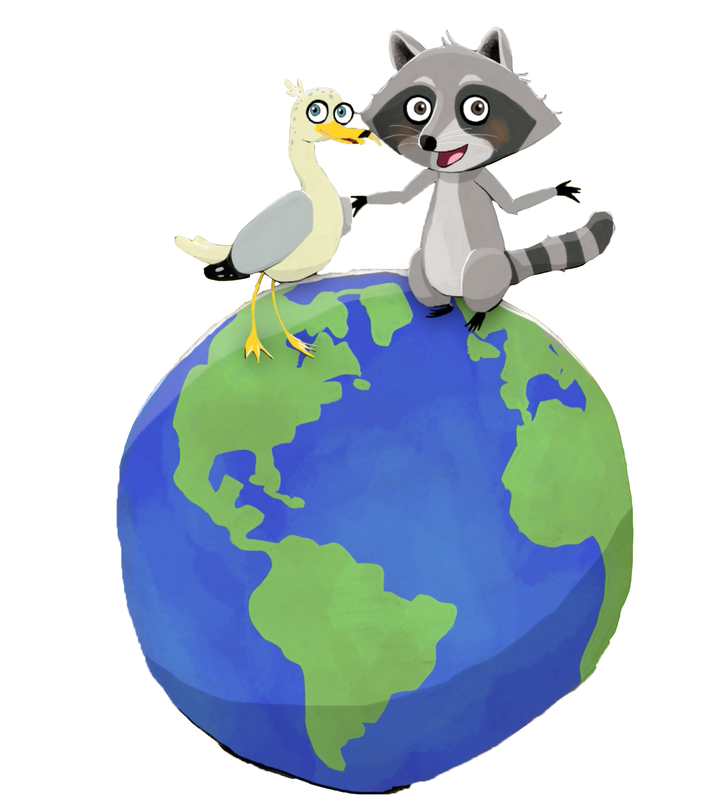
The ecological footprint
The ecological footprint (or environmental footprint) is an environmental assessment method and indicator that accounts for the pressure that humans place on natural resources and the “ecological services” provided by nature. (Wikipedia)
It allows for estimating the surface area (terrestrial or aquatic) necessary to enable an individual or country to support their way of life, have all the resources to meet their needs and eliminate their waste. (AlloProf)
Currently, if people all over the world were to consume like we do, it would take five planets to meet our needs.
That means we have a very big ecological footprint and that we are consuming too much compared to what Mother Earth can provide!

Slide 16
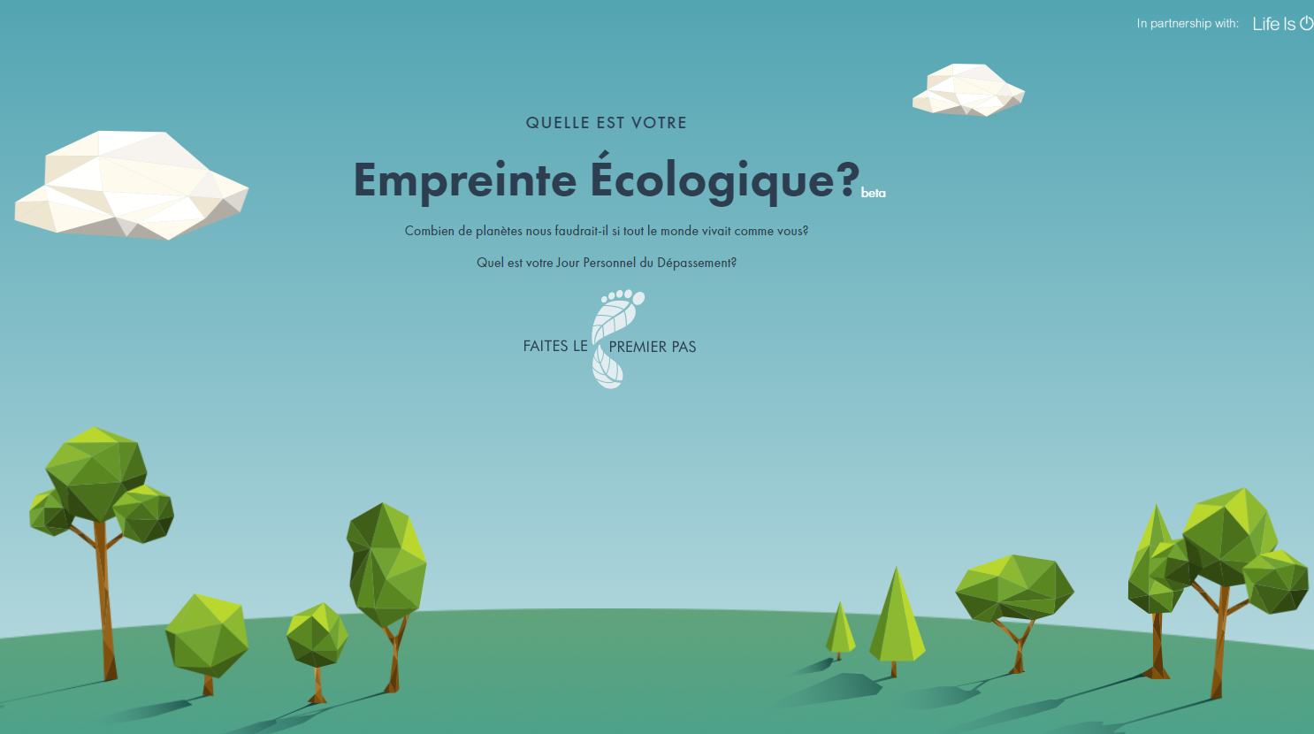
Our ecological footprint can be calculated!
CLICK HERE
to calculate your ecological footprint!

Slide 17
The trick to reduce our footprint?
4R-E
Reduce, Reuse, Recycle, Recover and Eliminate
85% of our “waste” could be reused, recycled, composted or recovered!
Our ecological footprint would be much smaller!

Slide 18
Circular economy

Slide 19
Consuming differently

Slide 20
Solutions
There are plenty of solutions to reduce our consumption and make better choices for Mother Earth.
In the immediate future, we can clean up our mess and pick up trash as soon as we see it on the ground, whether on the streets or in the forest!
The other challenges of the Educational Kit also prepare you to deal with the problem at its roots: the way we consume and the way we manage our waste.
Challenge 1: Properly sorting our waste: Where does it go?
Challenge 2: Zero waste
Challenge 3: Household hazardous waste
Challenge 4: Composting
Challenge 5: My ecological footprint

